Slide 1
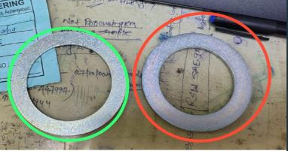
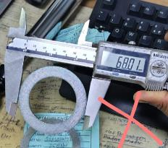
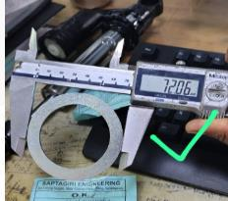

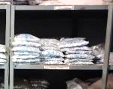
Action and Implementation
Complaint details:
Other Parts
Outer Dia Ø 68.0 mm
OK Parts
Outer Dia Ø 72.0 mm
Part Name : Washer
Part no :S2PL01712B
Defects :Wrong part received at ETL
Date : 04-12-24
Rejected Lot qty : 1500 nos
Part Name | Part No | Supplier | Defect | Actions | T. Date | Status
WASHER- YAMAHA (2GS) | S2PL01712B | SAPATGIRI INDUSTRIES | Defect Phenomenon – Wrong part received at ETL Why 1 : It’s a similar designed washer ( Other models’ washer ) :Why 2: finish good storage area its too nearer Why 3: Store person material place at others washer area Root Cause : Store person material place at others washer area | Containment action: 100 % material verified at ETL 100 % storage area which are lying material Inspection side action:. 1- Plane plug gauge made to verify ID 100% Cause Side Action: 1- Ensure material store at right place 2- Storage area identified by parts number 3- Awareness given to all concern workers Sustenance : 1 Storage area verified daily for no excess material store , no mixed , as identified store location, material should be placing right area ) | 05-12-2024 | Completed

