Slide 1
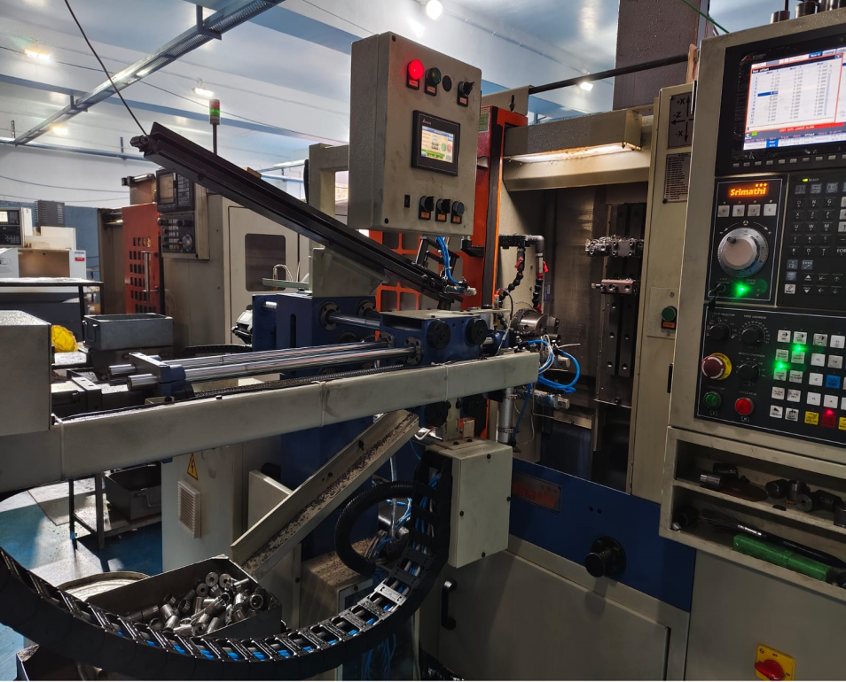
Countermeasure:- Machining stage
DRILL MACHINE :- SE/CNC/03 Date: 17/05/2025
BEFORE
AFTER
Problem/Present Status:
Countermeasure: Manually part loading shifted to auto parts loading by providing Shute and sensors.
Benefits :- NA

