Slide 1

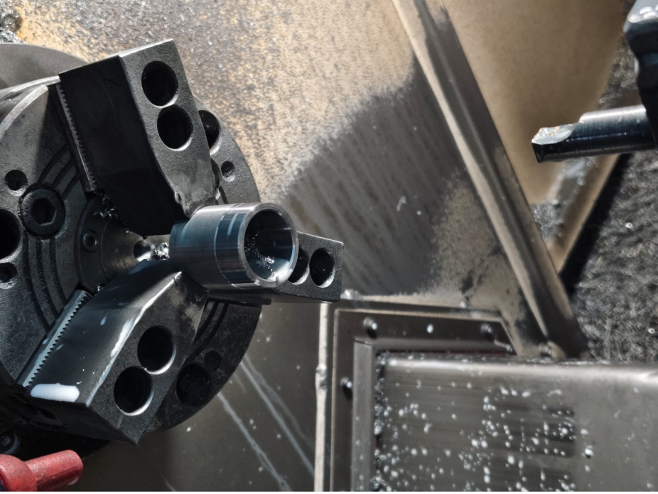
Countermeasure:- Machining stage
DRILL MACHINE :- SE/CNC/03 Date: 17/05/2025
BEFORE
AFTER
Problem/Present Status:
Manually part loading in the CNC chuck jaw, Parts getting tilt by manual loading
Countermeasure:
Benefits :- NA

