Slide 1
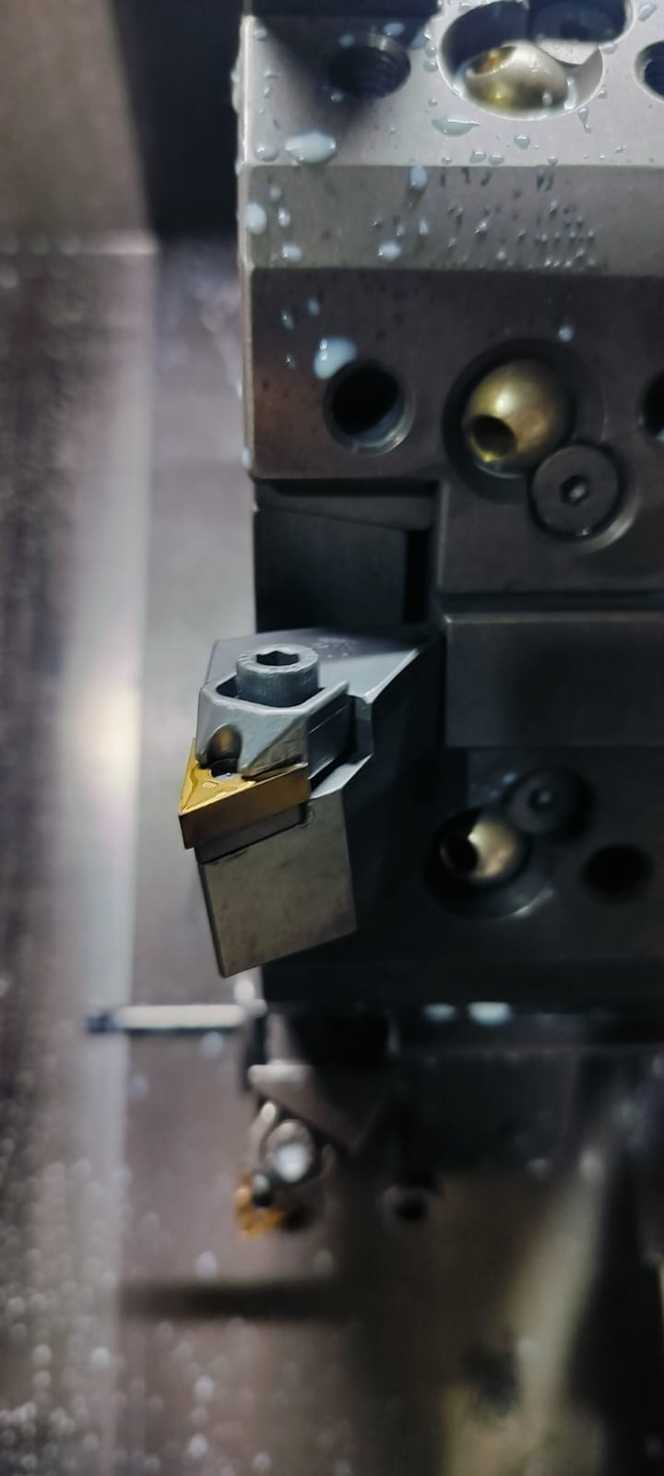
Action Plan Evidences
OCCURRENCE SIDE- AFTER
M Type Top is used for Clamping with 5.0mm Allen Bolt to Clamp the insert. This will improve tightening and insert will be clamped more rigidly.

Slide 2
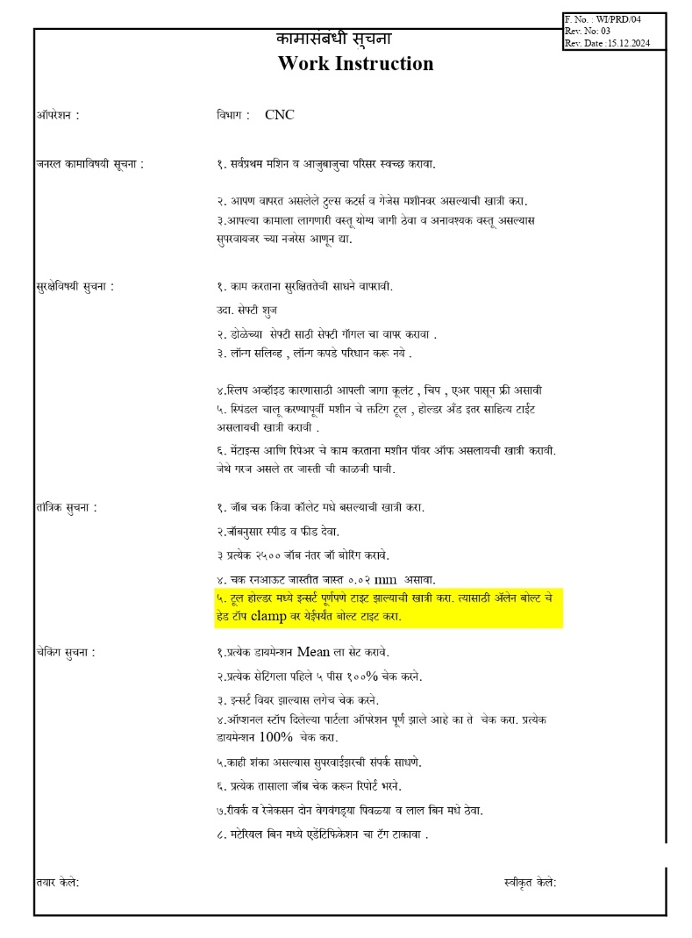
Action Plan Evidences
OCCURRENCE SIDE- AFTER
Updated Work Instruction

