Slide 1
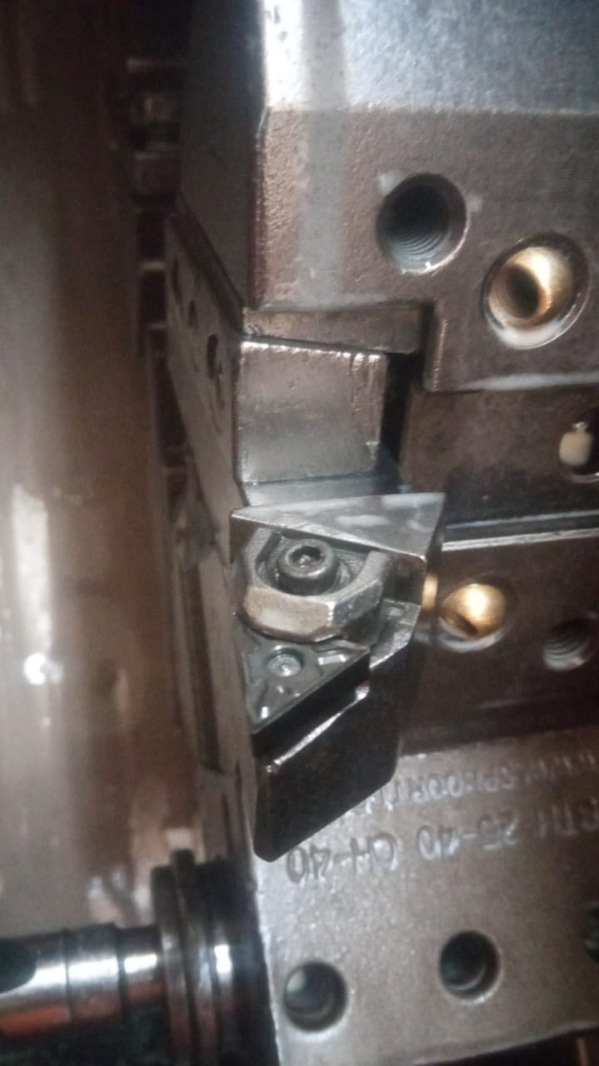
Action Plan Evidences
OUTFLOW - BEFORE
TNMG Insert Became Loose in Running Condition. Due to use of use of regular Top Clamp with 3.0mm Allen Bolt insert might have tightened with less rigidity.

