Slide 1
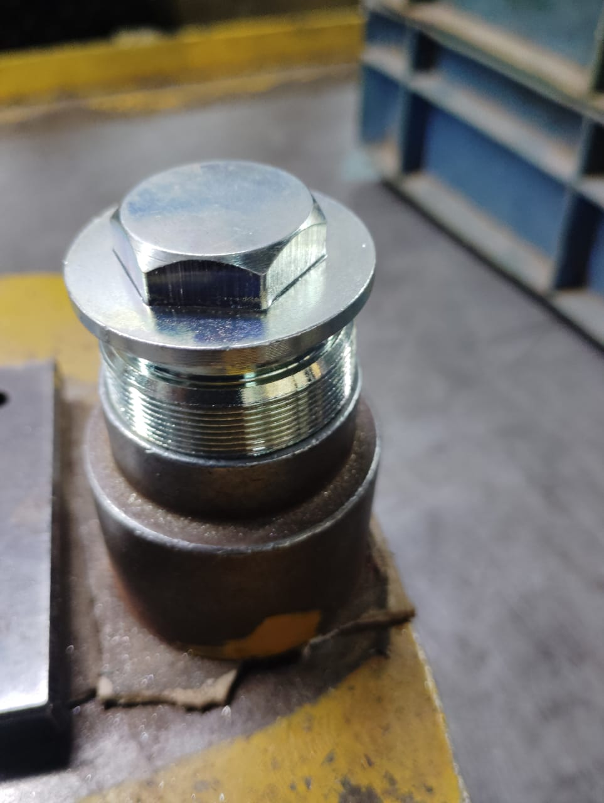
Action Plan Evidences
OUTFLOW - AFTER
Part checked with mating part after plating. Sampling Size increased to 50%. And if any part found not ok then 100% Lot inspection will be done

