Slide 1
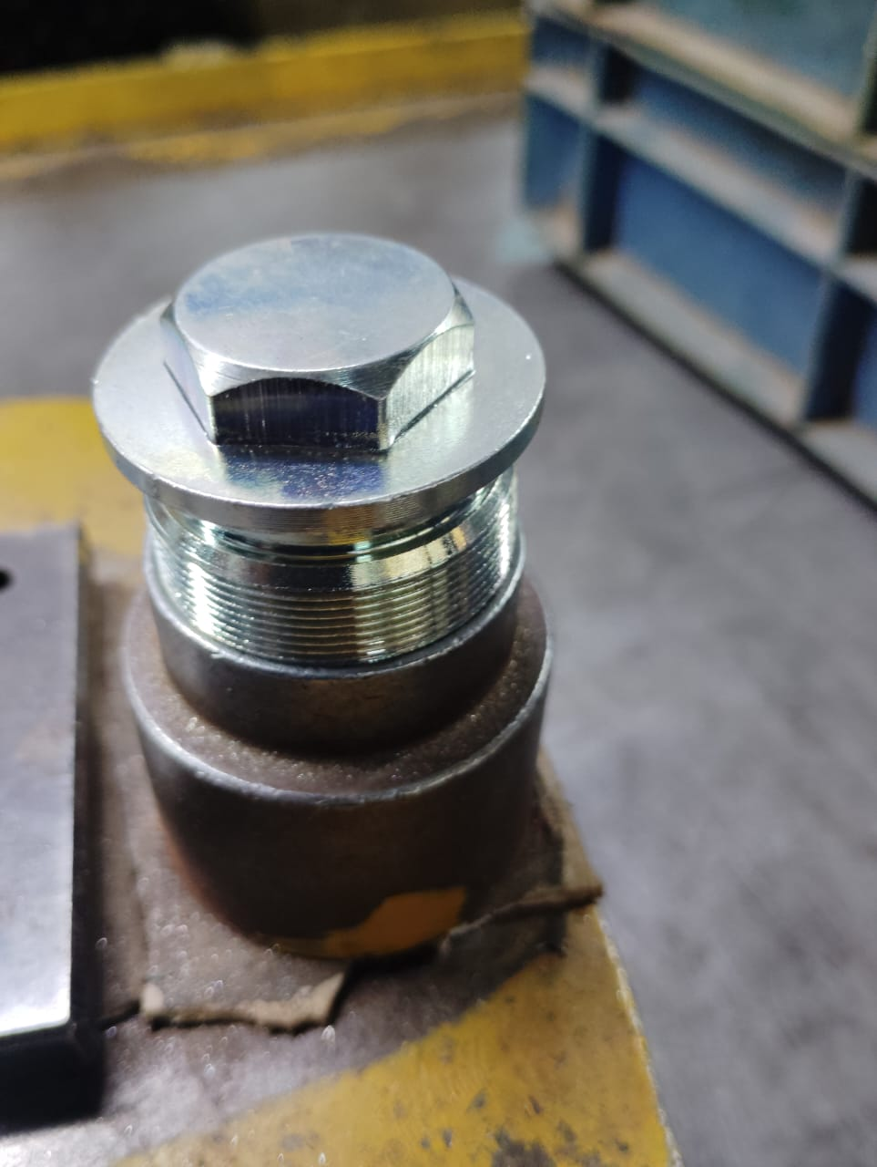
Action Plan Evidences
OCCURRENCE SIDE- BEFORE
Material checked with mating part on sampling basis.
Sampling Size 20%

