Slide 1
OCCURENCE - AFTER
100% Inspection of Major Diameter and Dia.26.20m Stared at Process stage. Instruction given to operator to take offset of 0.2-0.3mm after insert change. Effectiveness of this will be monitored and if such defects occurs at customer end again then threading will be don on thread rolling with pre-roll diameter maintaining in Grinding Operation.

Slide 2
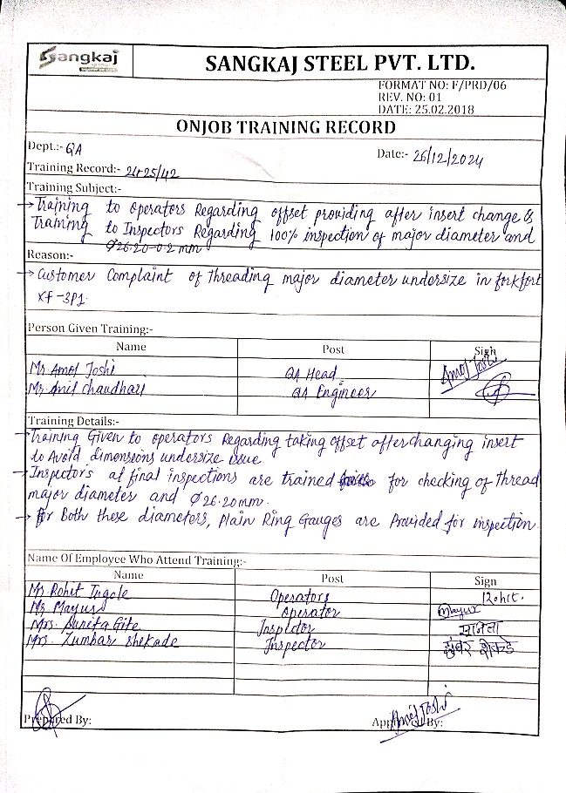
OCCURENCE - AFTER
Training Record
Control Plan

