Slide 1
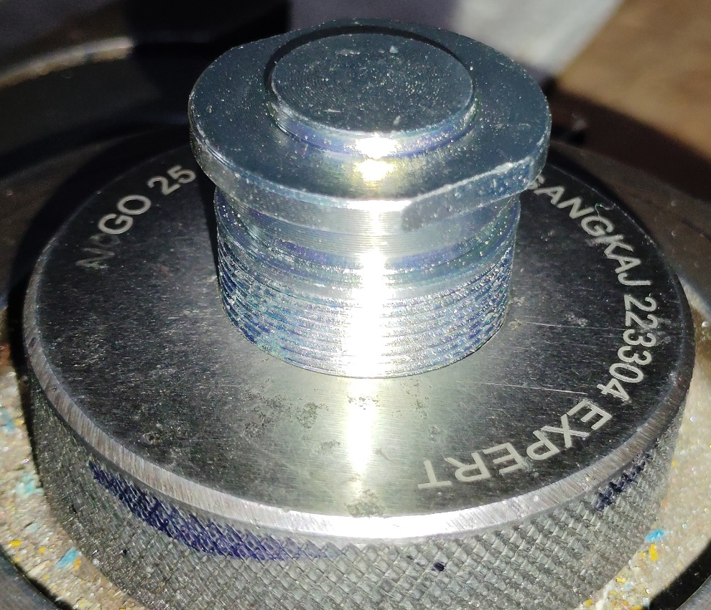
Action Plan Evidences
OUTFLOW - BEFORE
Inspection of Major Diameter of threading with Plain Ring No-Gauge

