Slide 1
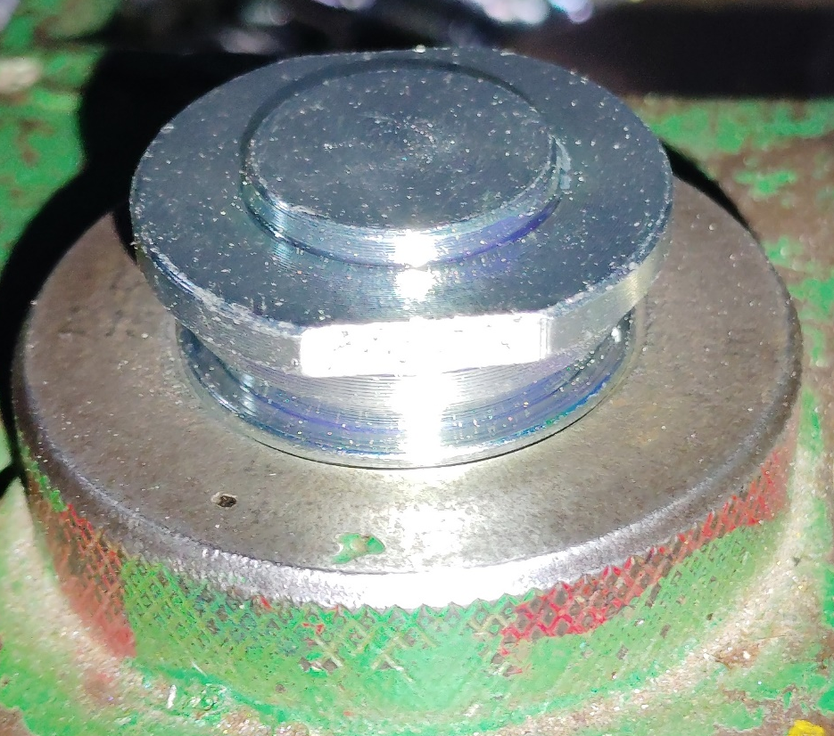
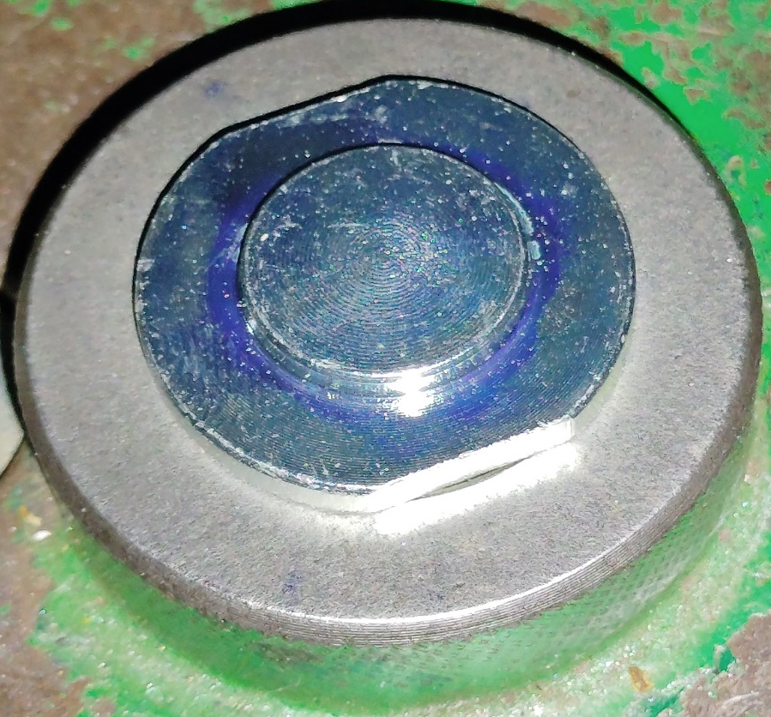
Action Plan Evidences
OUTFLOW - AFTER
No Go
If Dia.Ǿ26.20-0.2mm became undersize it will pass through No-Go Ring & as Major Dia. is also finished along with this diameter will get Detected.
Go
Major Diameter and Dia.Ǿ26.20-0.2mm are finished in one Turning Setup, So, to avoid major diameter undersize issue again, 100% inspection of Ǿ26.20-0.2mm is implemented along with Threading major diameter Inspection

Slide 2
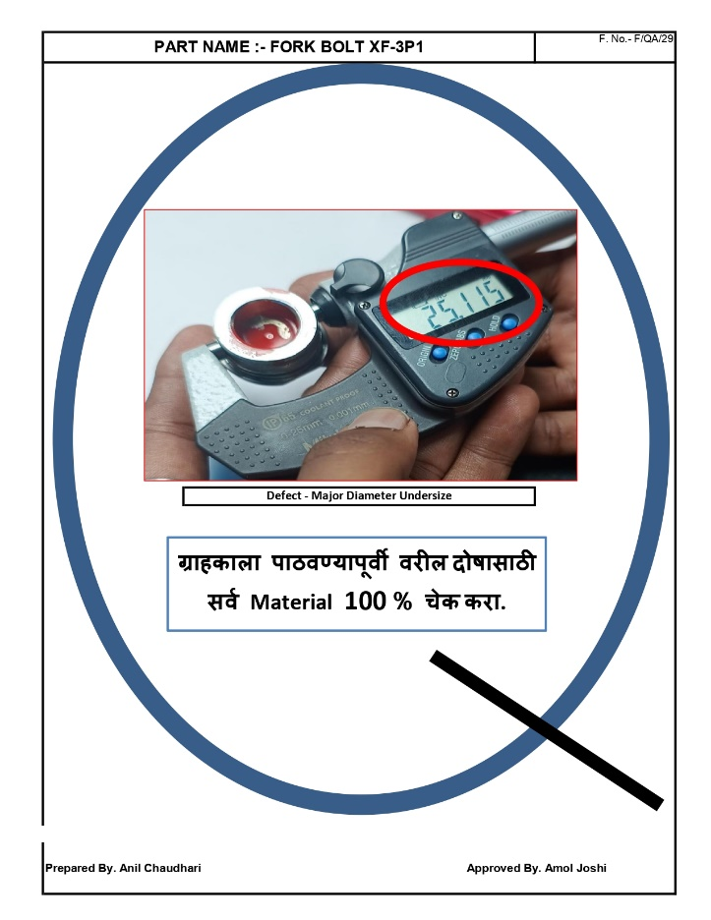
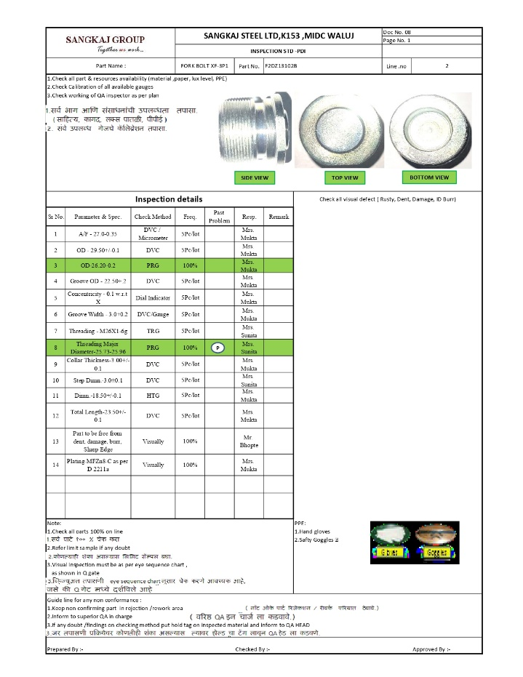
Action Plan Evidences
OUTFLOW - AFTER
Q -Alert
Inspection Standard

