Slide 1
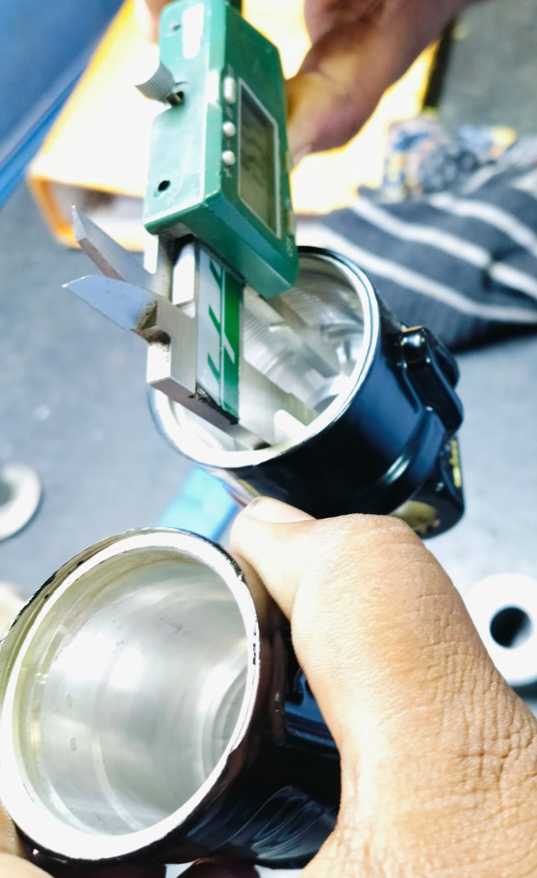
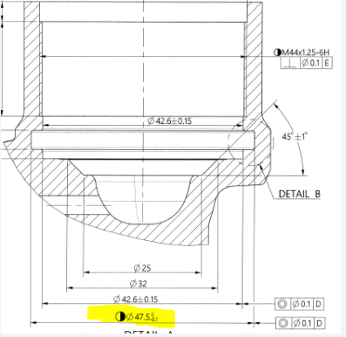
QSR Issues – Corrective actions
Part name & Part no. CANISTER -K10-P/C (S2BY01807B)
Model- Customer complaint :DEPTH U/SIZE.-ID FITMENT NOT OK DIA-47.5 -0.1 OBSERVED-47.0 MM.
Physical Phenomenon : Groove ID spec. 47.5 -0.1 observed 47.10 Under Size by 0.4mm.
Part Snap
Drawing Snap

Slide 2
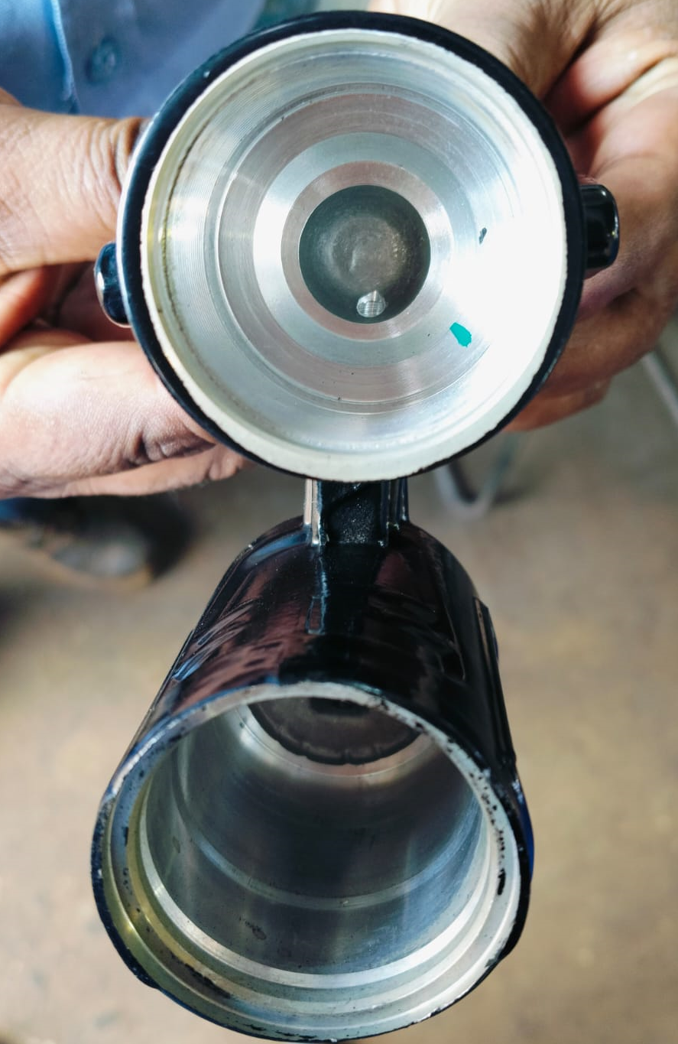
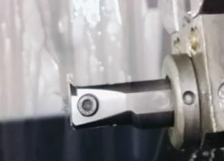
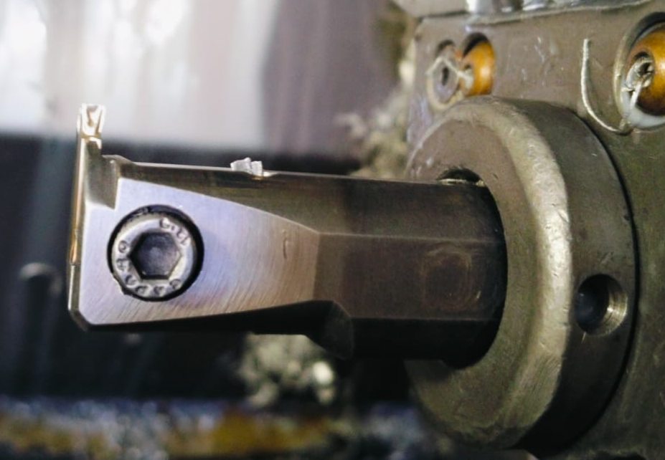
Corrective Action Details 98765-
Before
After
Groove ID spec. 47.5 -0.1 observed 47.45 OK –Observed within specification.
100% gauges inspection Dot marking started.
DEPTH U/SIZE.-ID FITMENT NOT OK DIA-47.5 -0.1 OBSERVED-47.0 MM
Groove ID spec. 47.5 -0.1 observed 47.10 Under Size by 0.4mm.
Insert wear out in running conditions.
New insert changed and tool change frequency revised.
Part Name | Model | Vendor | Defect | Actions | T. Date | Status
CANISTER -K10-P/C (S2BY01807B) | CANISTER -K10-P/C | MCTPL | Customer complaint – DEPTH U/SIZE.-ID FITMENT NOT OK DIA-47.5 -0.1 OBSERVED-47.0 MM. Physical Phenomenon – Groove ID spec. 47.5 -0.1 observed 47.10 Under Size by 0.4mm. Why 1;.Groove ID under size by 0.4mm. Why 2: Due to Insert wear out. Why 3: Wear out in running condition and Insert not change before wear out. Why 4 : Not detect in regular production. Why-5:-Because insert wear before a as per decided tool life.. Root Cause:. Insert wear before a as per decided tool life. | Containment Action :- 1. .ETL End – 113 Qty rejected by ETL and Found 286 nos OK 2. . Available stock at Supplier end verified for Dim 47.5 whole lot qty -370. 3.Awareness given to all concern person with Q alert. Inspection side action Supplier End (MCTPL):- 1. Provided vernier & 100% inspection started at final inspection stage. 2. Available stock at Supplier end verified for Dim 47.5 whole lot qty -370. 3. 100% dot marking started at inside near groove. Inspection side action ETL End:- 1-Segregation completed at ETL End – 113 Qty rejected by ETL and Found 286 nos OK . 2- Q Alert displayed. Cause Side Action:- 1.New insert changed and setup completed. 2.After changing insert ,Tool life monitoring started and insert life to be fixed (Now insert to be changed after 3000 no's ). 3. New insert to be procured for maintaining min max stock. | 28.12.2024 28.12.2024 28.12.2024 29.12.2024 28.12.2024 27.12.2024 27.12.2024 27.12.2024 02.01.2025 05.01.2025 | Completed Completed Completed Completed Completed Completed Completed Completed Completed Completed
HORIZONTAL DEPLOYMENT : NA
SUSTENANCE (PREVENTIVE) ACTIONS 1.Tool life sheet monitoring daily 2.Check sheet Layer Audit .
SYSTEM ACTIONS :-In process Inspection, Process Audit & Product Audit

Slide 3
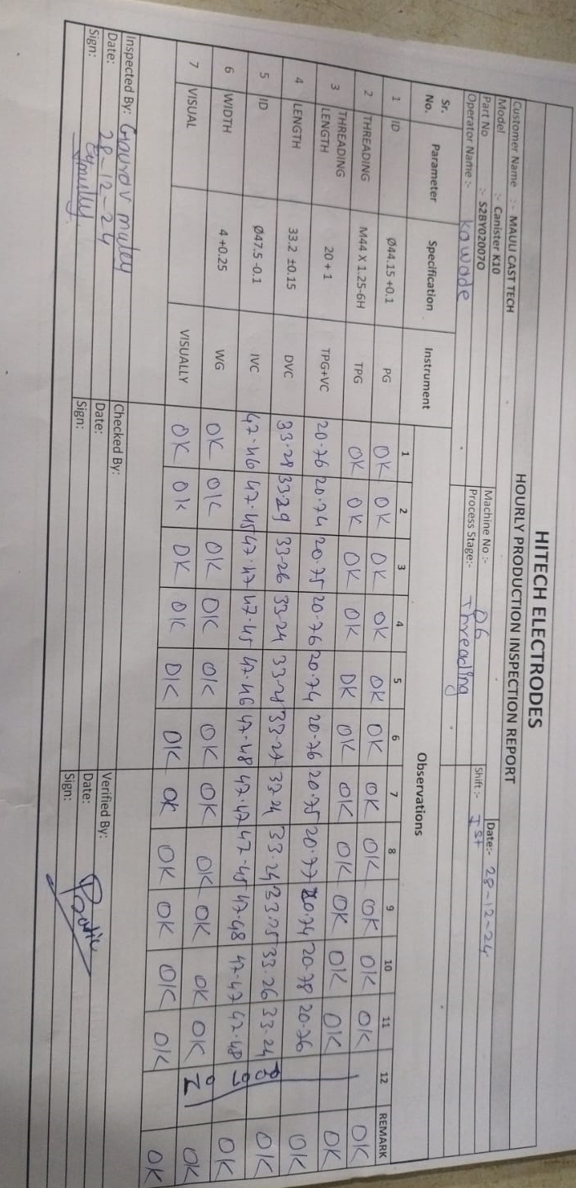
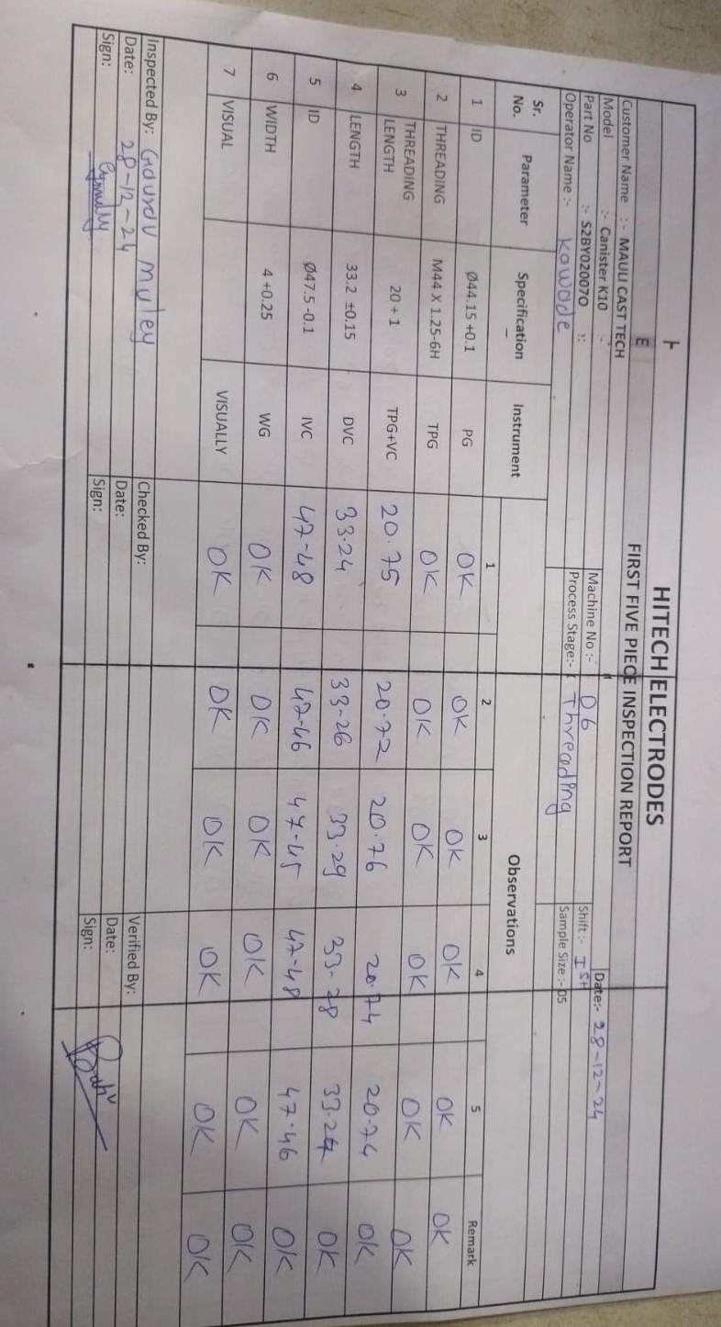
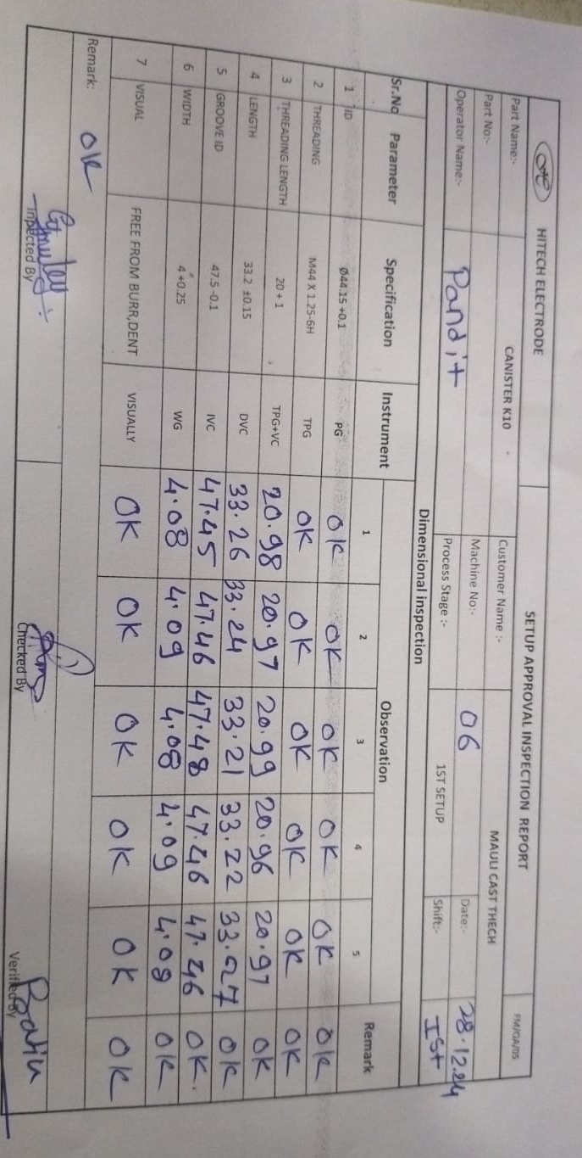
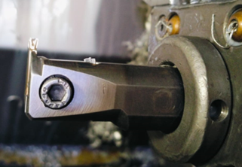
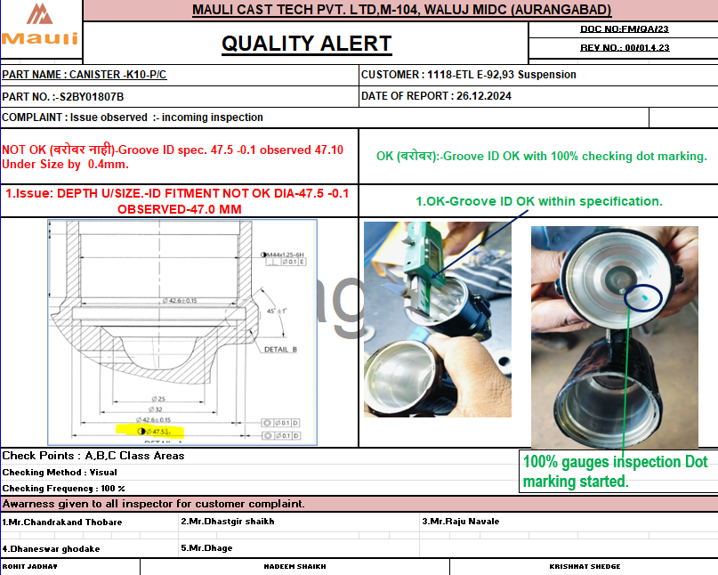
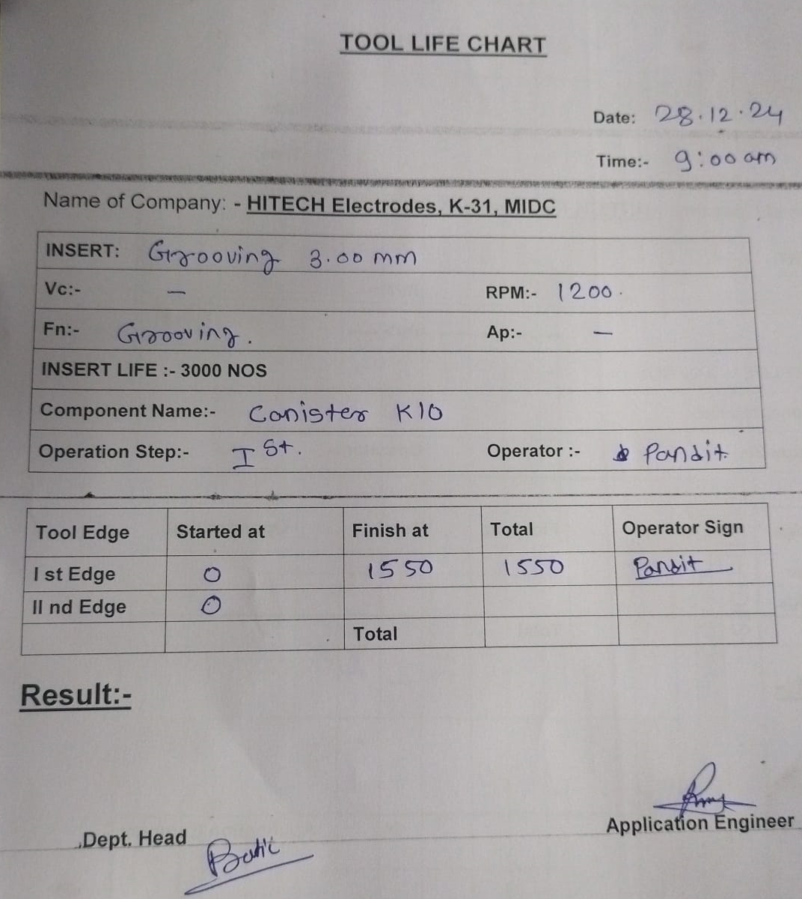
Evidences
Supplier End Evidences
New insert with maintaining min max stock
100% inspection at final inspection stage with Dot marking
Supplier Check point added in process, Hourly inspection & setup inspection reports.
Before insert life is 4000 no’s.
Certified lot identification mark details.
Quality alert
Now insert life fixed-3000 no’s Reduced tool life after customer complaints.

