Slide 1
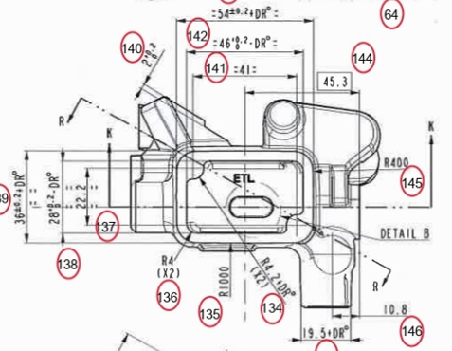
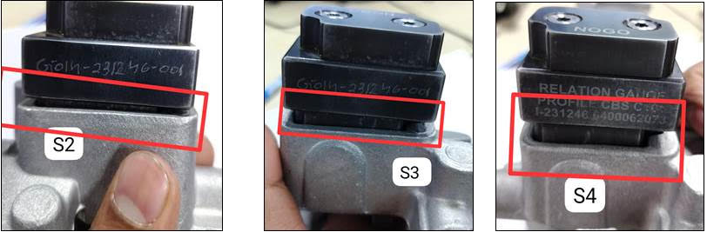
QSR Issues – Corrective actions Date:-20.12.2024
Part name & Part no. Front Master Cylinder-C101 (B2GQ019030)
Model- Customer complaint :Inner pocket dimn. 46+0.2-DR and 28+0.2-DR found not ok (Under size, pocket gauge not passing completely).
Physical Phenomenon : Dimn. 46+0.2-DR and 28+0.2-DR Under size
Part Snap
Drawing Snap

Slide 2
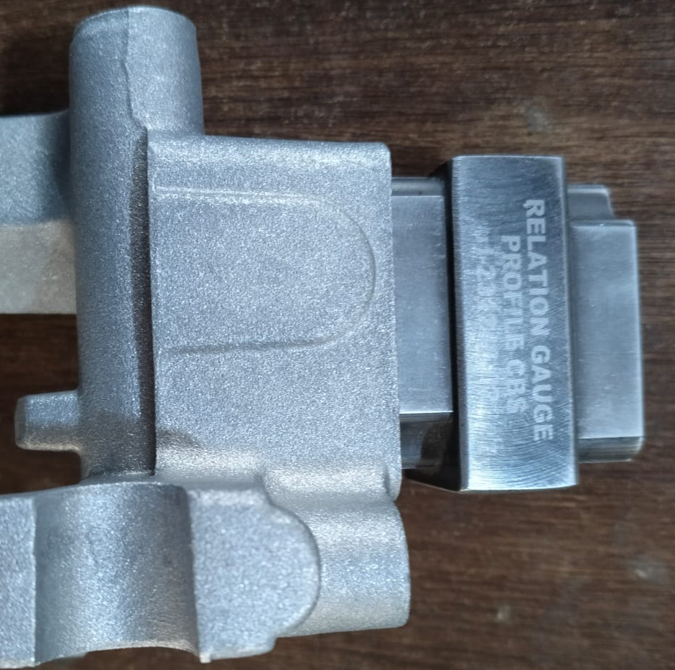
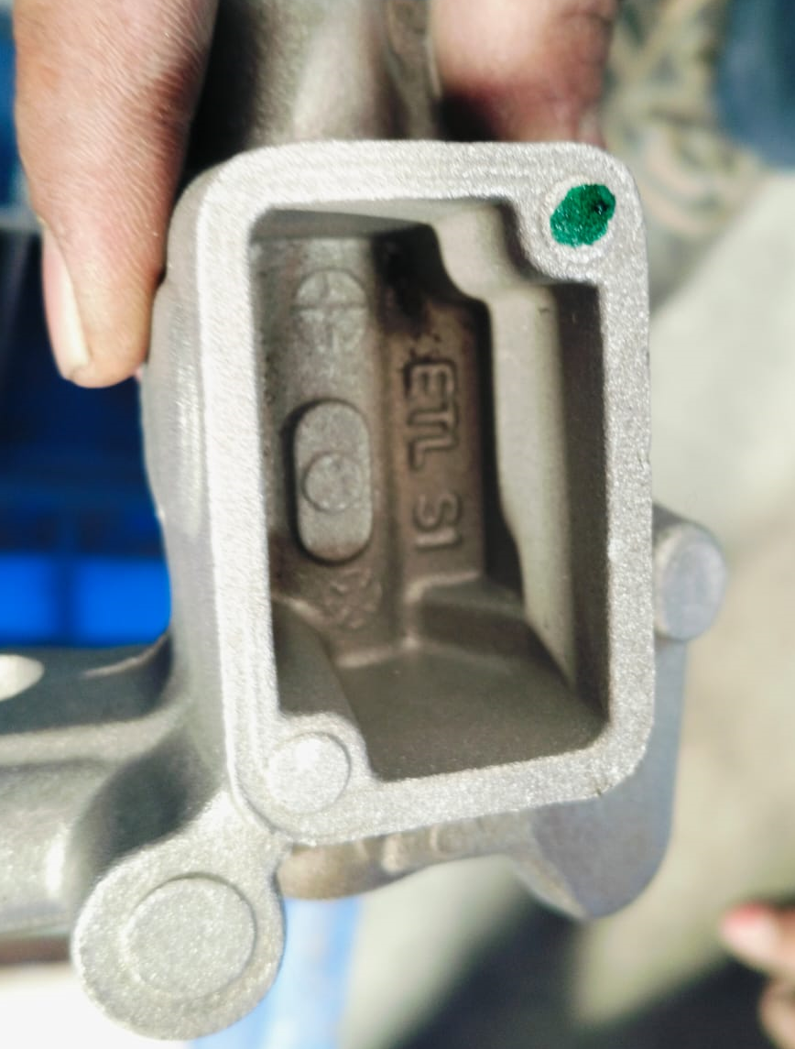
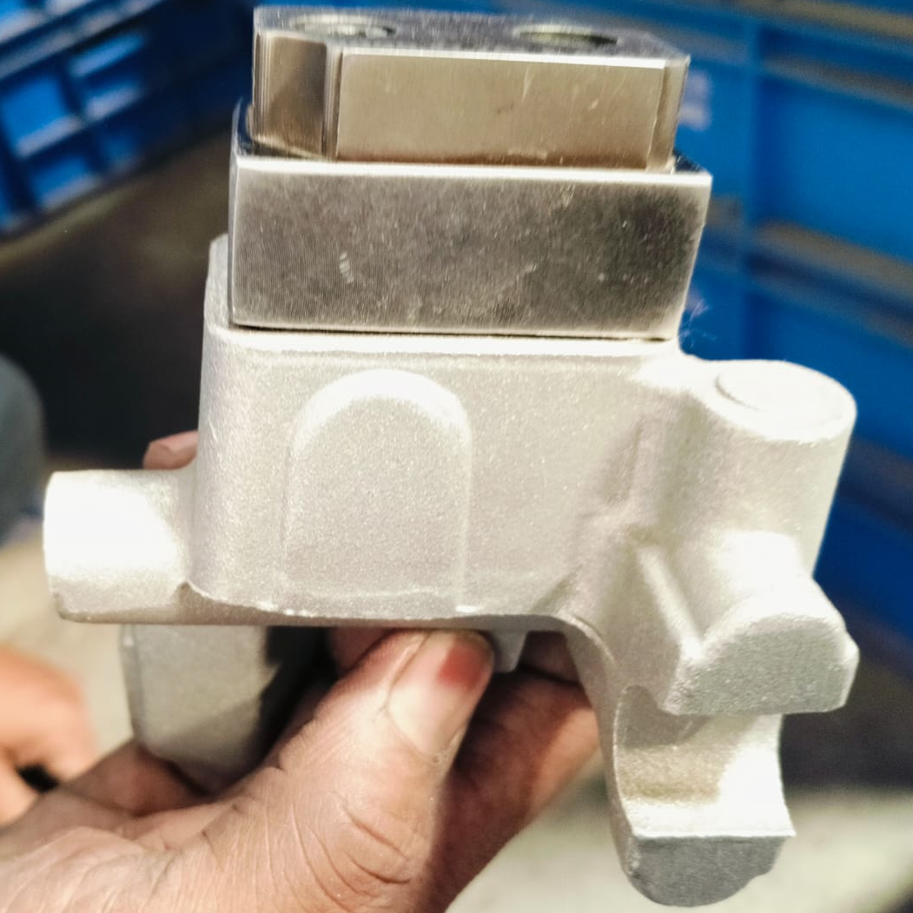
Corrective Action Details
Before
After
Go gauge not passing completely.
Punch Wear out By 0.020 mm to 0.040 mm
100 % Go gauge passing completely
100% gauges inspection Dot marking started.
Part Name | Model | Vendor | Defect | Actions | T. Date | Status
Front Master Cylinder-C101 | B2GQ019030 | MCTPL | Customer complaint:- Inner pocket dimn. 46+0.2-DR and 28+0.2-DR found not ok (Under size, pocket gauge not passing completely, All 4 cavity)- .Physical Phenomenon – Found go gauge not passing in RFD part _Dimn. 46+0.2-DR and 28+0.2-DR Under size Why 1;.Go gauge Not passing completely. Why 2: Pocket Dimn found under size by 0.020 to 0.040 mm . Why 3: Casting pocket Dimn. Not ok/Under size. Why 4 : Pocket punch wear out during running. due to online correction . Root Cause:1. Pocket punch wear out due to frequent polishing on punch surface. | Containment Action :- 1.ETL End – 1008 Qty 2.Available stock at Supplier end 100% verification started for Dimn 28 & 46 (1540 no’s in WIP At MCTPL End) 3.Awareness given to all concern person with Q alert. 4.100% gauges inspection started at final inspection stage with Dot marking. Inspection side action Supplier End (MCTPL):- 1. Provided gauge & 100% inspection started at final inspection stage. 2.This Dimn. Check by special profile gauge during setup & in-process inspection. Inspection side action ETL End:- 1.All suspected parts will be segregated. Cause Side Action:-1.Tool/punch life monitoring started and Punch life to be fixed (Now Punch life decided is 10400 shots ). 2. New punch to be procured for maintaining min max stock | 1.21.12.2024 2.21.12.2024 3.20.12.20244.20.12.2024 20.12.2024 21.12.2024 28.12.2024 31.01.2025 | ,------ In process In process Completed Completed Completed Completed Completed In process
HORIZONTAL DEPLOYMENT : TVS FRONT MASTER CYLINDER
SUSTENANCE (PREVENTIVE) ACTIONS ;. 1.Die PM plan 2.Check sheet Layer Audit , 3.Weekly verified punch life data.
SYSTEM ACTIONS :-In process Inspection, Process Audit & Product Audit.

Slide 3
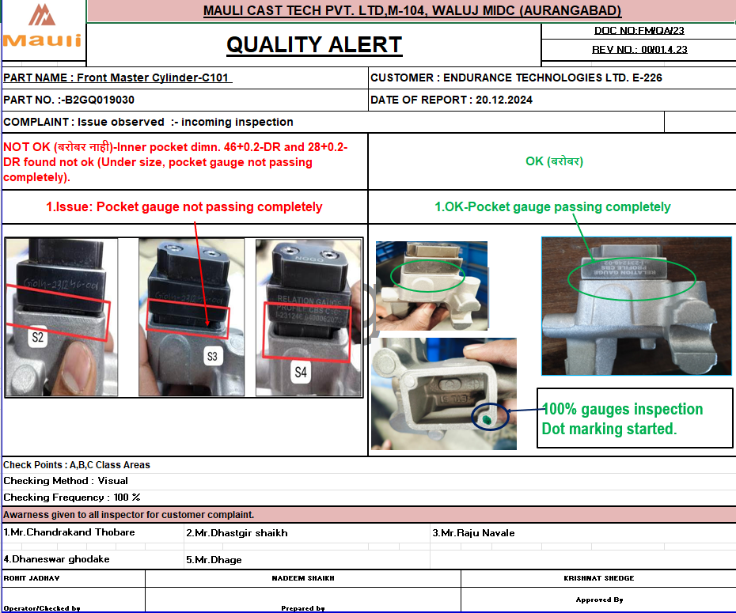

Evidences
Supplier End Evidences
100% gauges inspection with Dot marking started.
100% inspection started at final inspection stage with Gauge
Q Alert Display at final inspection and production stage.
Punch life monitoring

