Slide 1
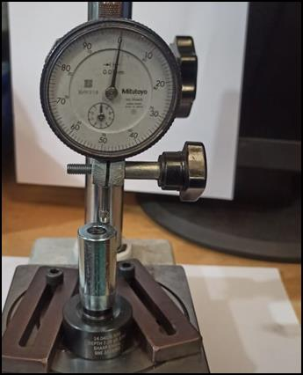
Countermeasure:- MACHINING STAGE
EVIDENSES
TRAUB OPERATION : SE/ALM/05
BEFORE
AFTER
Detection side
inspection
being done by
attribute type gauge.
Problem/Present Status:1. 1. Relation gauge used for checking 100% parts but not effective by concentricity checking gauge .
Countermeasure:
M/s Sharp made available Spl. Dial type gauge for DIM 7.0+/-0.1 mm checking at final & in process inspection stage to avoid man oriented inspection. Gauge implemented & checking on daily basis.

