Slide 1
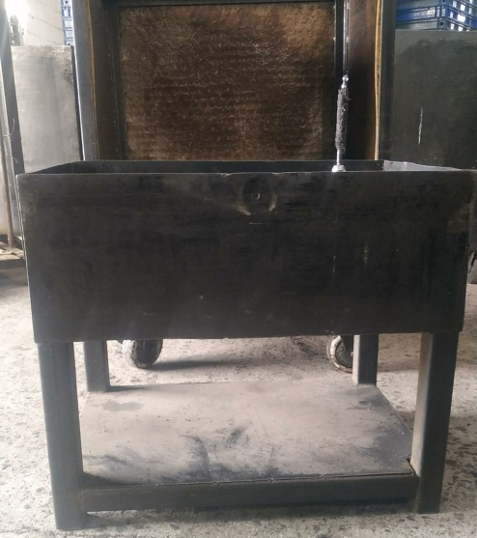
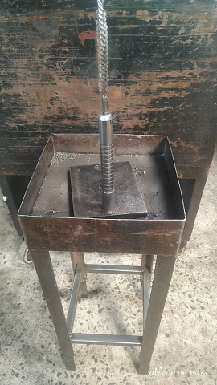
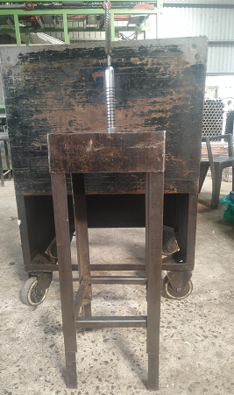
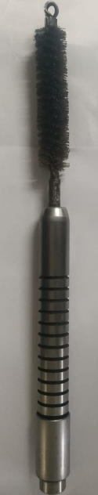
Inspection Side Before & After
Before
After
285 mm
380 mm
Inspection System :-
Inspection Method :-
Inspection Location :-
Inspection Frequency at Each Location :-
Other Details :-
Operator not able detected that Part is fully Inserted & rest at bottom of Deburring Poka- Yoke Fixture Cause of Deburring Fixture Table Height is Less (380 mm ) & Burr Collecting box height ( 285 mm ) is More.
Inspection System :-
Inspection Method :-
Inspection Location :-
Inspection Frequency at Each Location :-
Other Details :-
Deburring Poka-yoke Fixture table Height will Increase to 4 feet & Burr Collecting box height reduced to 80 mm .
So Operator will easily detect that Part is fully Inserted & rest at bottom of Deburring Poka-yoke Fixture.

Slide 2
One Point Lesson

Slide 3
Work Instruction

