Slide 1
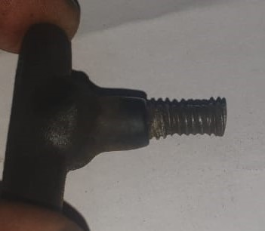
Countermeasure taken
Operation: Final Inspection
Target date:01.06.2022
Earlier soft material M.S bolt used for Key ,due to which some parts not proper tight fitted in plating fixture with key,by which parts not properly get current in process ..
BEFORE
.

