Slide 1
Monthly rejection analysis and Actions on vendor rating, Customer rejection / returns
Supplier Name:- ANANT ENTERPRISES
Part category:- Bottom case

Slide 2
Action plan for common defect on following parts
Part Name:- K0LA Drum
Defect:- Blow hole

Slide 3
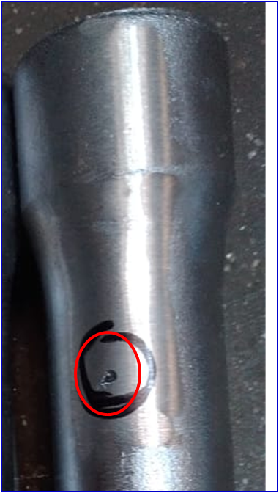
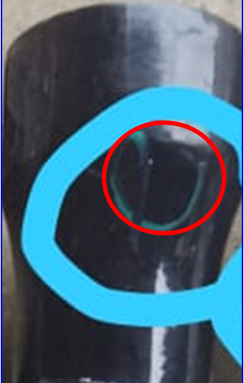
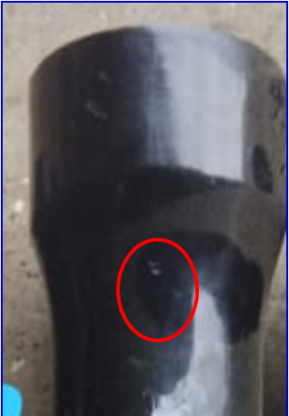
Defect phenomenon in K0LA DRUM

Slide 4
STUDY OF CAUSE & SIMULATION TEST
Sr. No. | 4M | Probable causes | Fact verification | Test Result | Remark
1 | Man | Operator skill | Skilled operator. | Found ok | Ok
2 |  | Operator process Knowledge | Operator have knowledge of process | Found ok | Ok
1 | Machine | Casting solidification timer | Solidification time 100+10 second | 100 sec | Ok
2 |  | Die temp veriation | Die temp found within specification. | 359°C | Ok
3 |  | Ejection not proper | Casting ejection done smoothly | Found OK | Ok
4 |  | Shrinkage feeding not proper | Blow hole open after buffing on ingate near oil seal OD. | Metal turbulence | Not OK
1 | Method | Die cleaning process | Die cleaning done as per decided frequency | Found ok | Ok
2 |  | Die maintenance | PM done as per the PM check sheet. | Found ok | Ok
3 |  | Die coating | Die coating done properly | Found OK | Ok
4 |  | Air vents cleaning | Air vents found OK | Found OK | Ok
1 | Material | Molten metal temperature. | Molten metal temperature found OK | 729°~743°C | Ok
2 |  | Inclusion / foreign particles in molten metal | Degassing done as per decided frequency | Found ok | Ok
3 |  | Degassing not done effectively | DI observed less than 2 | DI 0.4 Found ok | Ok

Slide 5
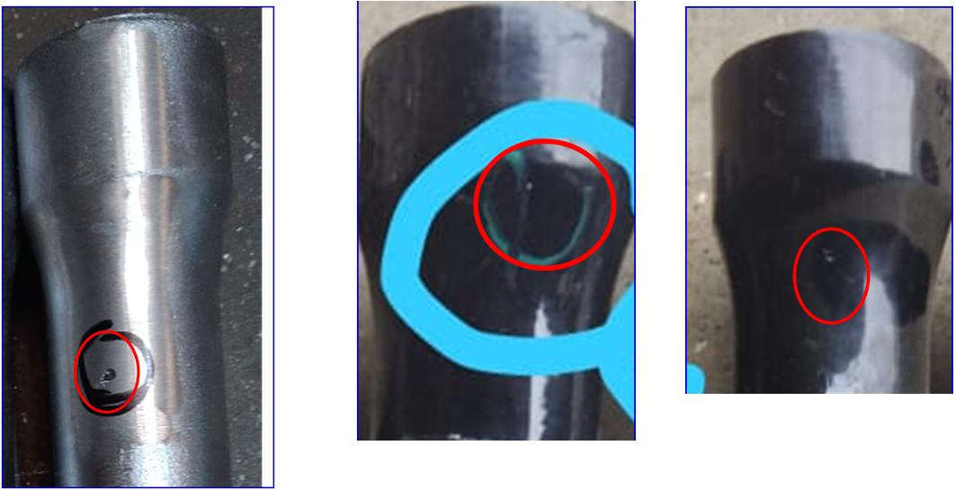
Root cause analysis, Validation
Part:- K0LA DRUM
Defect:- Blow hole
Why:- Shrinkage feeding not proper near oil seal area
Why:- Turbulence create during molten metal pouring
Why:- Ingate thickness more than requirement of casting section
Root cause Validation
Ingate thickness more than requirement of casting section hence turbulence creates during molten metal pouring.
Turbulence resulted in to blow hole on ingate.

Slide 6
THANKS

