Slide 1
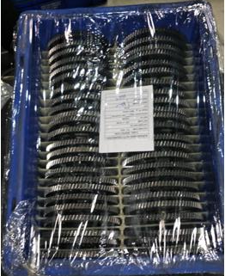
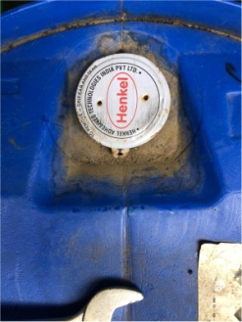
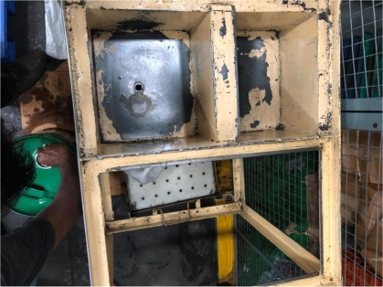
Action Plan –M/s AAEPL
Part Name | Defect Phenomena | Rejection Qty | Defect Photograph | Root Cause (Why-Why Analysis) | Counter Measure (Action Plan) | Target Date | Evidence | Status | Effectiveness Monitoring
JZ551400 (Gear primary Driven) | Rust Observed in Gear teeth | 500 nos |  | Occurrence (Cause) Side:- Components store in bin open conduction at RFD room. After oil application completed anti rust oil dry in two to three days . | Occurrence (Cause) Side:- After oiling bin wrapping started 100% be fore handover to dispatch . Anti Rust oil replaced Growdal DX 30 to Henkel lubricants . Oil Tank Cleaning frequency reduced 7days to 3 days | Implemented |  | Completed | Point Added in IPO Audit

