Slide 1
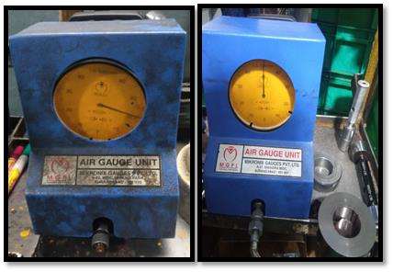
Before-Defective Air Gauge Unit
After- OK Air Gauge Unit

