Slide 1
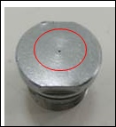
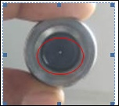
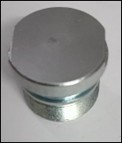
ONE POINT LESSON
Shop:- Final Shop |  | Machine:- Fork Bolt K-86
Class |  |  |  | Lesson no | 10
 |  |  |  | Date of preparation | 10.06.2022
 | Basic knowledge | Improvement class | Trouble shooting class | TPM leader | Shende
 |  |  |  | Section leader | Mukta
Topic:-Through hole in Fork Bolt K-8
Key Points:- No through hole
Know Why:- Prevent Customer Complaint.
×
Date | 10.06.2022
Teacher | Mr Shende
Learner | Mrs. Mukta | Mrs. Sheeta | Mrs. Zumbad

Slide 2
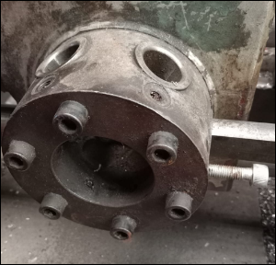
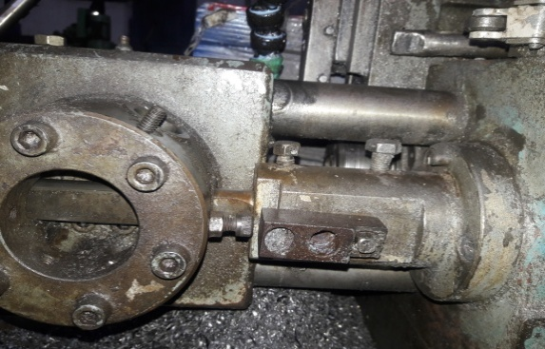
ACTION PLAN – Through Hole In Fork Bolt – K86
Shop: SANGKAJ STEEL PVT LTD.
Implementation Date: 11.06.2022
BEFORE | AFTER
Adjustment nut worn out. | Adjustment nut replaced with new one.
Not OK
OK

