Slide 1
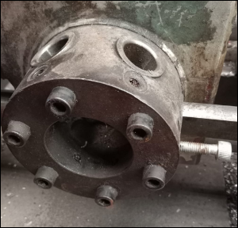
ACTION PLAN – Through Hole In Fork Bolt – K86
Shop: SANGKAJ STEEL PVT LTD.
Implementation Date: 11.06.2022
BEFORE | AFTER
Adjustment nut worn out.
Not OK

