Slide 1
Welcome

Slide 2
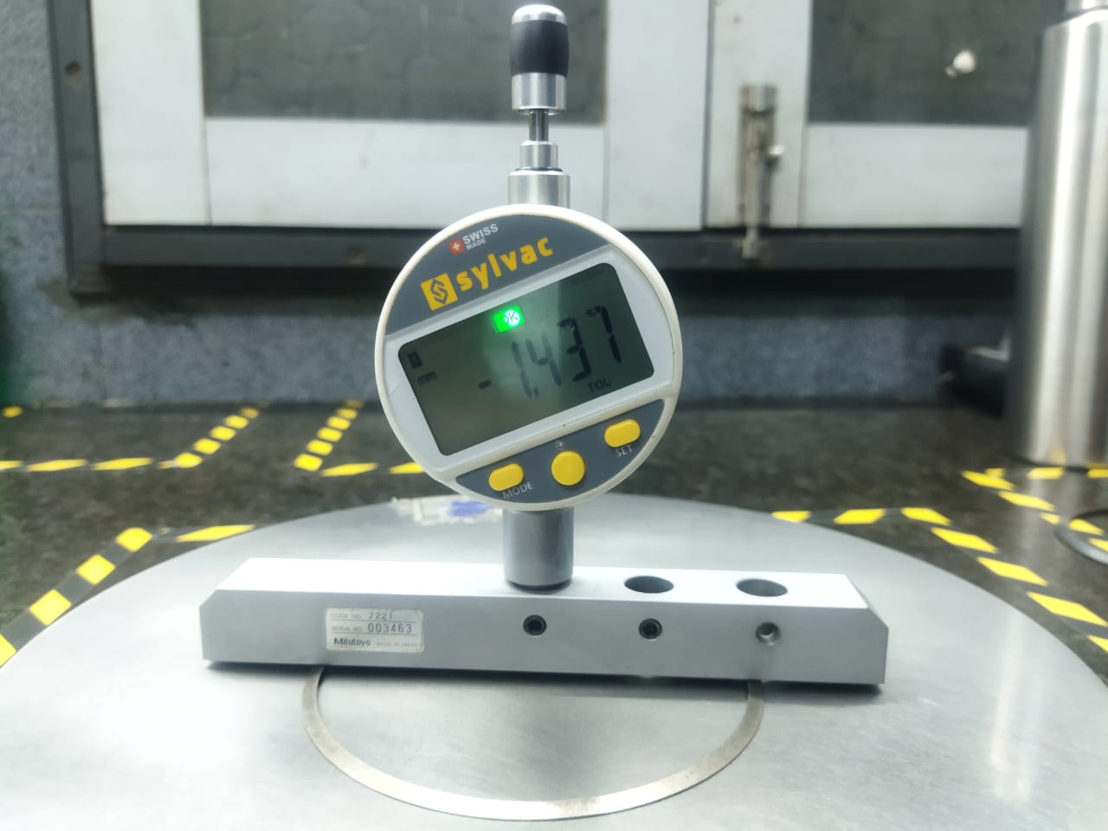
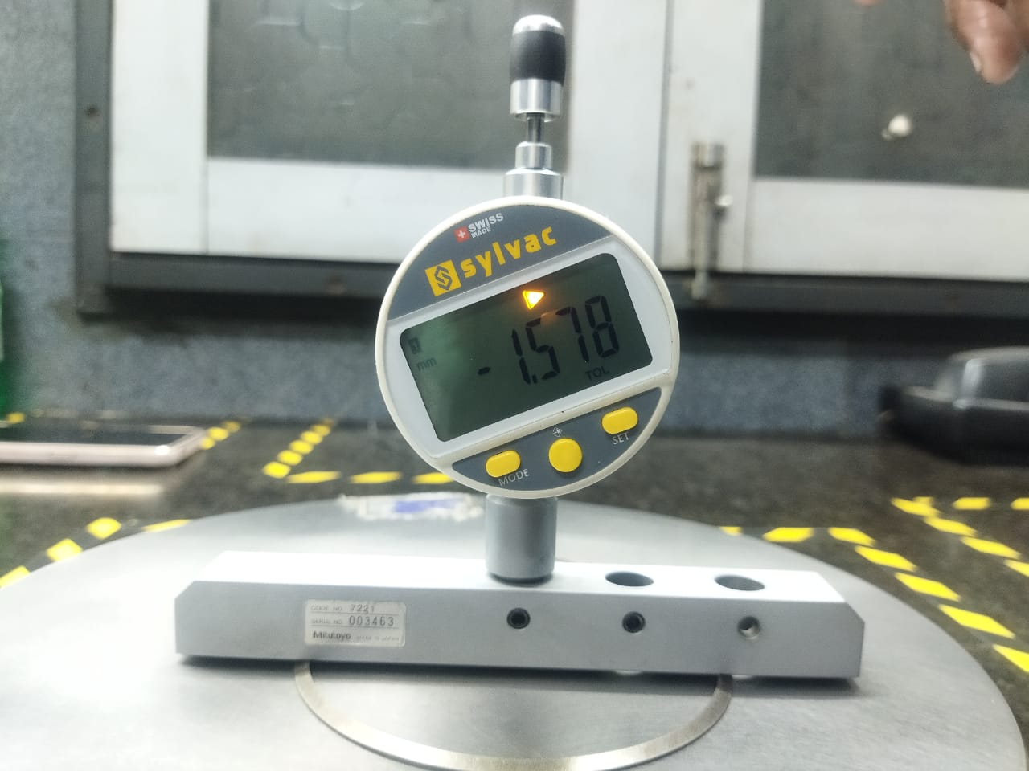
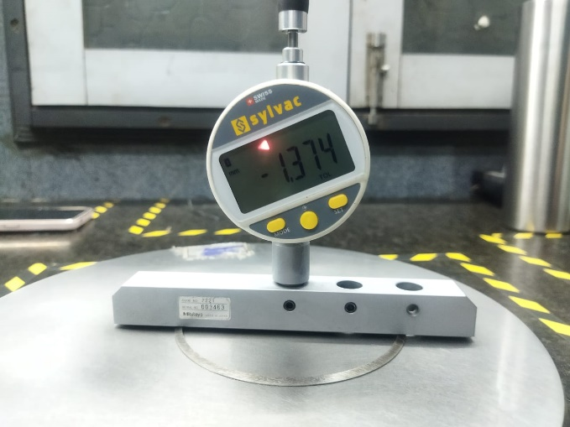
Height Checking on Digital gauge
OK
OVERSIZE
UNDERSIZE

Slide 3
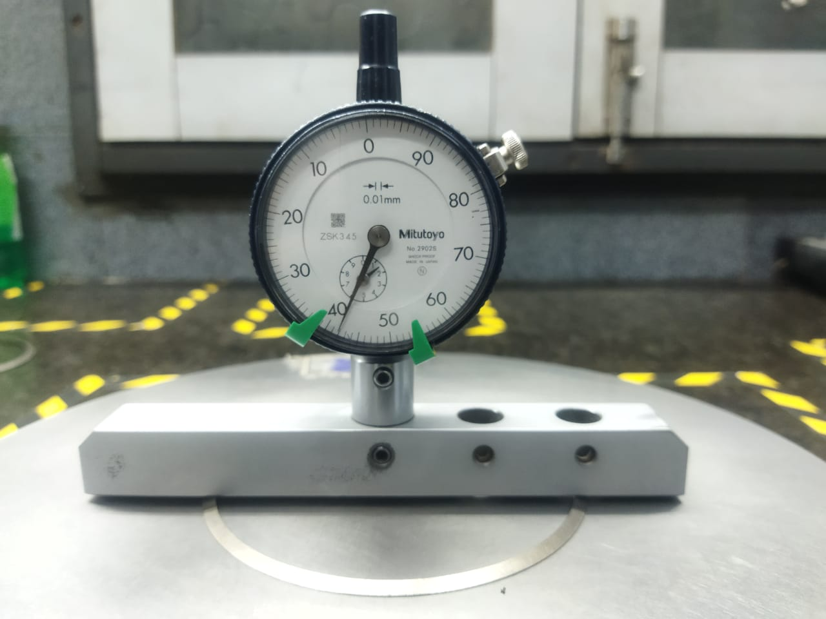
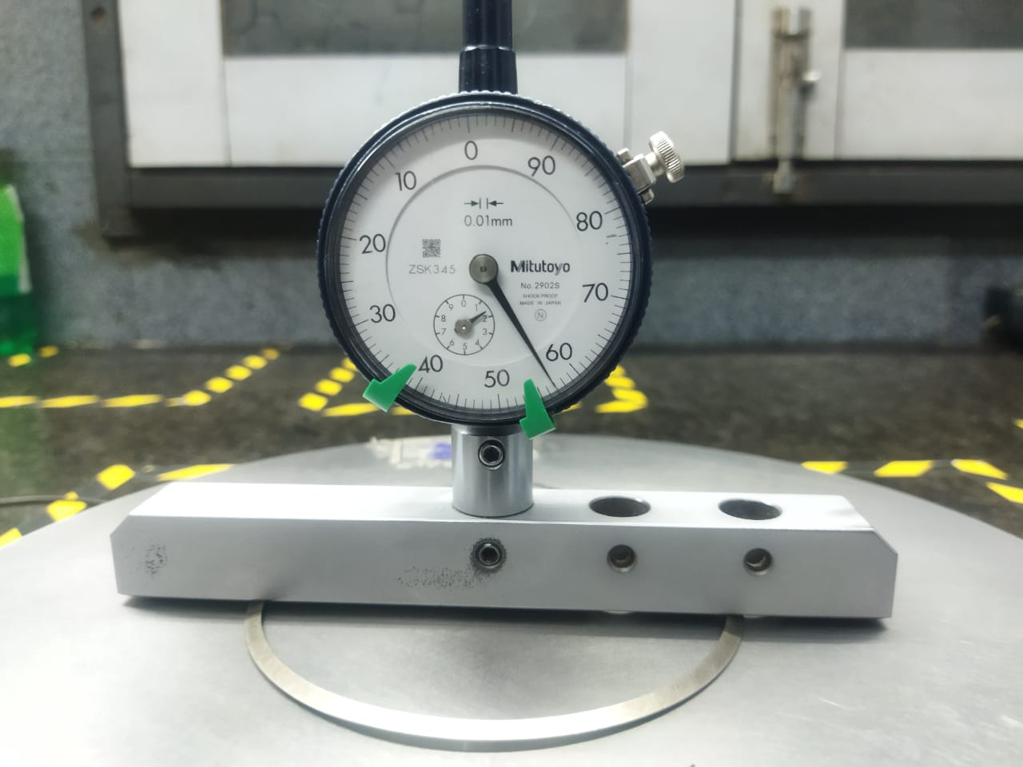
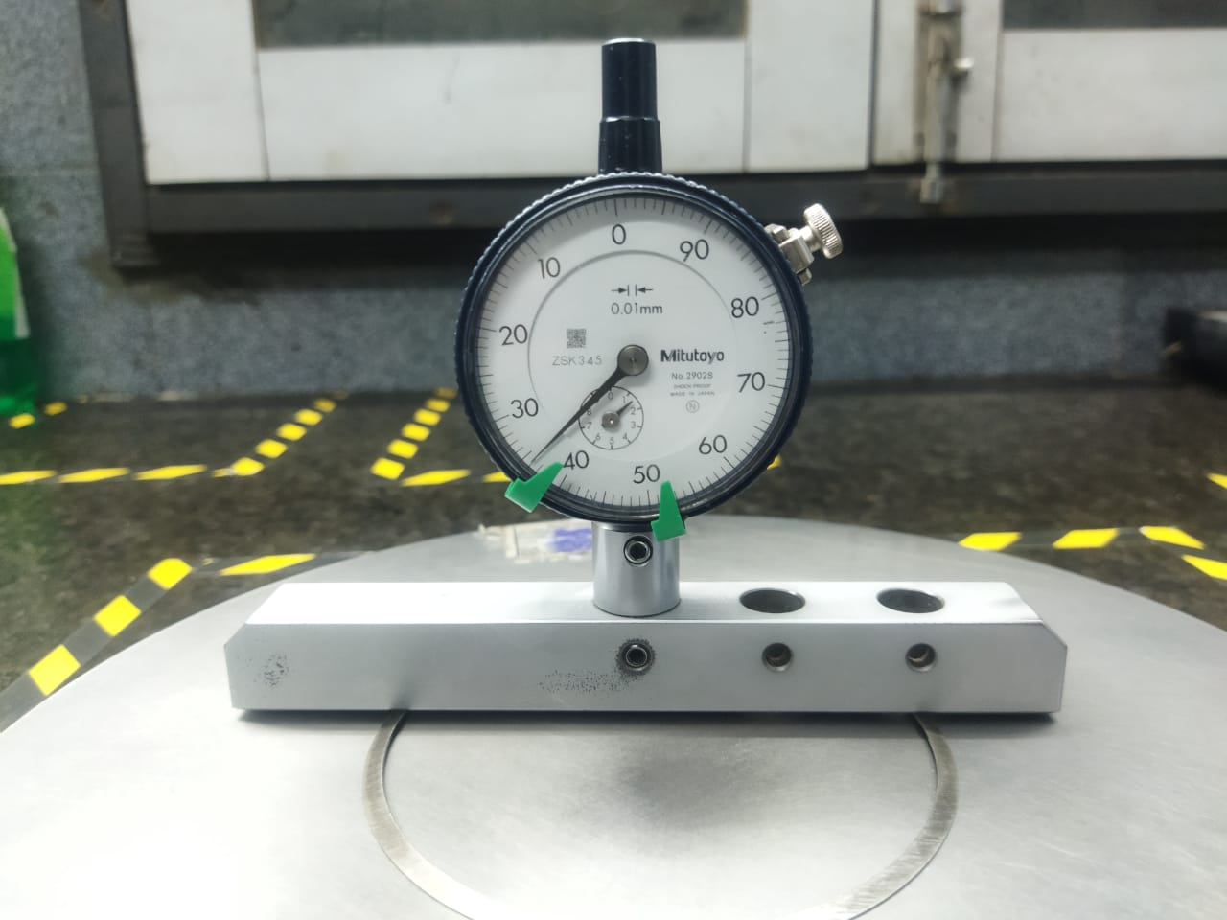
Height Checking on Dial gauge
OK
OVERSIZE
UNDERSIZE

Slide 4
Thank You

