Slide 1
Welcome

Slide 2
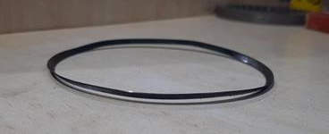
Part No : C2CH00302B
Part Name : JUDDER SPRING
Quality Issue : Bend Piece observed At Customer End.

Slide 3
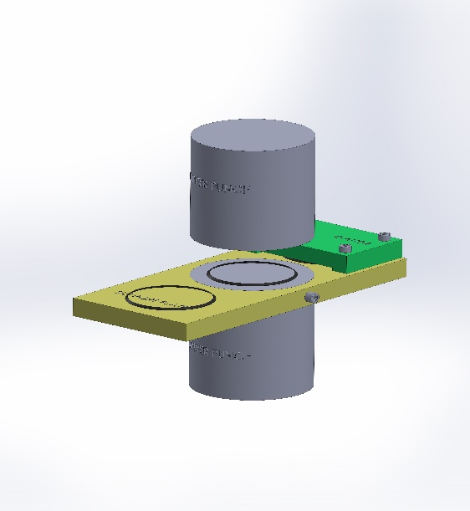
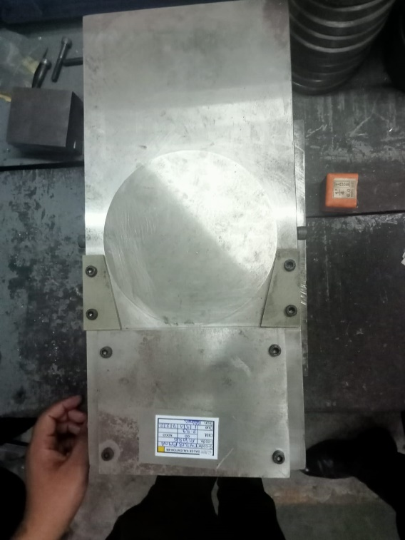
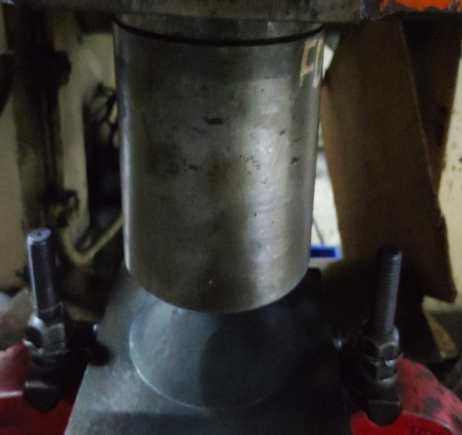
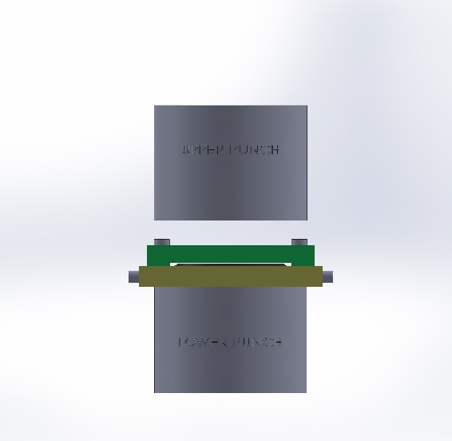
ACTION TO BE TAKEN FOR OCCURRENCE LEVEL
Tool Made for other Model
1) There was no provision of Height & Flatness detection in existing Scragging operation on Scragging Tool.
2) Possibility of Excess Flatness & height be passed for further operation.
1) Provided provision of Height & Flatness detection in proposed Scragging operation on Scragging Tool.
2) There is no possibility of passing of excess Flatness & height for further operation.

Slide 4
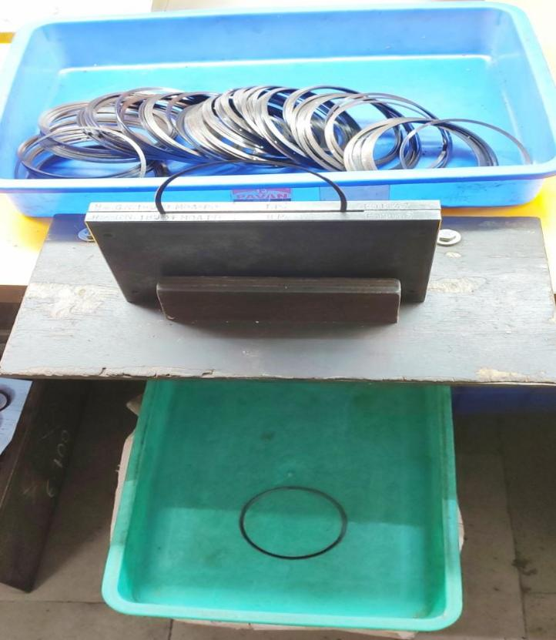
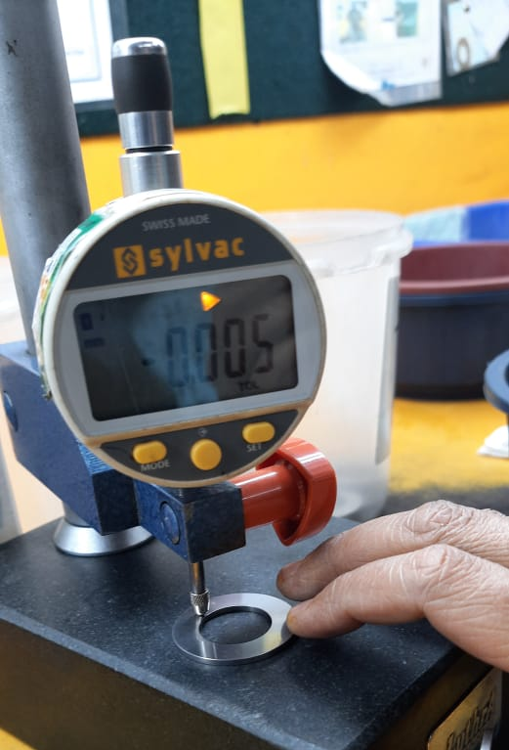
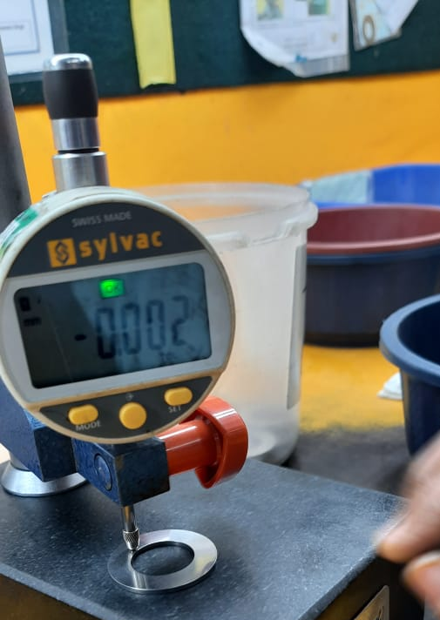
ACTION TO BE TAKEN FOR NON DETECTION LEVEL
Current Gauge Checking
Proposal Checking method

Slide 5
Thank You

