Slide 1
Socket Head Pinch Bolt J1A
Observation : Low plating thickness observed on plated components
( 4-6 Micron Against Min 8 Micron Dated 09.06.2022)

Slide 2
Process Validation done after complaint
Sr.No. | Critical Process | Parameters | Before | After | Observation | Controls | Results
01 | Degreasing | Concentration Temperature Lot size | 65 – 70 gpl 60-80 deg 30 kg per lot | 65 – 70 gpl 60-80 deg 30 kg per lot | gpl Deg 30 kg per lot | Analysis Te. Controller Weighing Scale | Ok Ok Ok
02 | Anodic cleaning | Concentration Temperature Lot size | 50 – 80 gpl 60-80 deg 30 kg per lot | 50 – 80 gpl 60-80 deg 30 kg per lot | 68 gpl Deg 30 kg per lot | Analysis Te. Controller Weighing Scale | Ok Ok Ok
03 | Acid Pickling | Concentration Temperature Lot size | 30 – 50 % Room temp 30 kg per lot | 30 – 50 % Room temp 30 kg per lot | 50 % Room temp. 30 kg per lot | Volume / Volume Manual Weighing Scale | Ok Ok Ok
04 | Zinc Plating | Zinc Conc. Caustic Conc. Temperature Current Time Lot Size | 10-15 gpl 120-160 gpl 20-35 deg 7-8 v / 300-350 amp 75 mint 45-50 kg | 10-15 gpl 120-160 gpl 20-35 deg 8-9 v/400-450 amp 75 mint 30 kg | 14.25 gpl 148 gpl 28 deg 8.9 v / 430 amp 75 mint ( PLC Set ) 30 kg | Analysis Analysis Temp.controller Rectifier display & Records Weighing Scale | Ok Ok OK Ok Ok Ok
05 | Passivation | Concentration | 100 ml / ltr | 100 ml /ltr | 100 ml/ litr | Analysis | Ok
06 | Topcoat | Concentration | 100 ml / ltr | 100 ml /ltr | 100 ml /ltr | Analysis | Ok
07 | Drying | Temperature | 60-80 deg | 60-80 deg | 72 deg | Temp.controller | Ok
08 | Thickness | Min-8 micron | Min 8 micron on DFT | Min 8 micron on XRF tester | 12.2 to 14.6 on XRF tester |  | OK

Slide 3
Cause Analysis
Defect
Low thickness observed on plated components
Why 1
Process done on parts as per regular lot size
Why 2
Because of small parts its required different lot size & current supply
Why 3
Not detected by regular thickness tester ( DFT)
Why 4
XRF thickness reading is less than regular thickness tester reading
Immediate Actions
Action 1 : All pipeline material has been taken for rework & all batch wise checking done
on XRF thickness tester before dispatch the material , its batch wise record will
be maintained .
Permanent Actions
Action : Plating will done on Valid parameters & its records maintained as per
requirements .

Slide 4
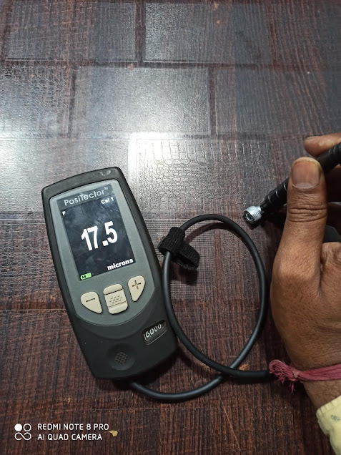
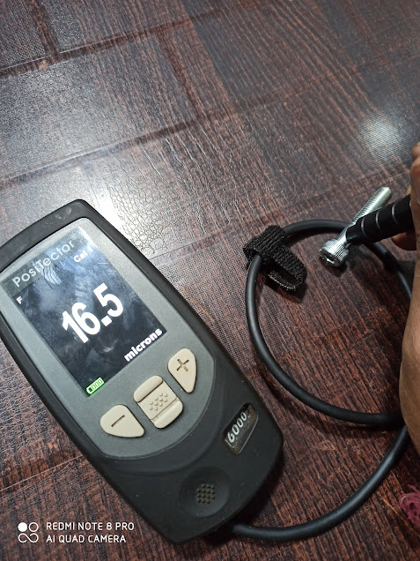
Thickness reading on DFT meter against XRF reading of 12 – 14 microns

Slide 5
Thank You

