Slide 1
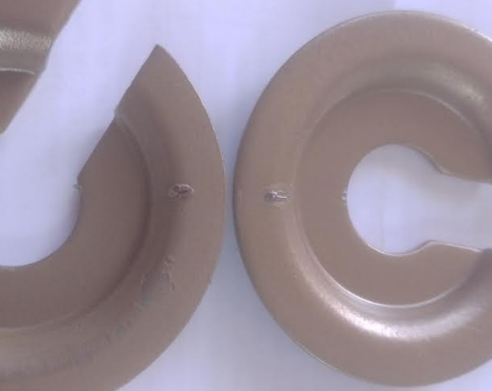
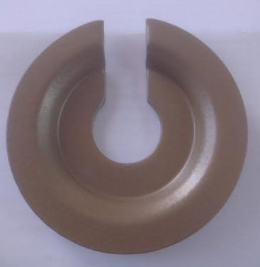
One Point Lesson
Premier Enterprises
Shop:-Coating shop |  | Part:- TOP Spring Locator, Stage: Inspection
Types of Problem |  |  |  | Lesson no | 51
 |  |  |  | Date of preparation | 07/06/23
 | NOT OK | OK |  | Team leader | Mr.Deokar
 |  |  |  | Zone leader | Mrs.Deshmukh
Topic:- Powder coating not OK
KEY POINTS : Locator must be free from powder coating defects.
NOT OK
OK
Date | 07.06.23 | 08.06.23 | 09.06.23 | 10.06.23
Teacher | Mrs.deshmukh | Mrs.Deshmukh | Mrs.Deshmukh | Mrs.deshmukh
Learner | Mrs.Meera | Mr .Sachin | Mrs.Radha | Mr.Vikas

