Slide 1
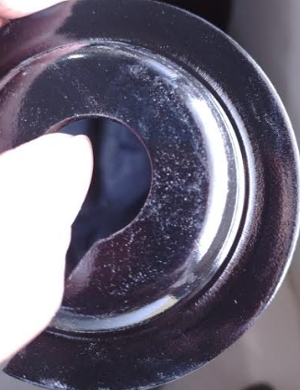
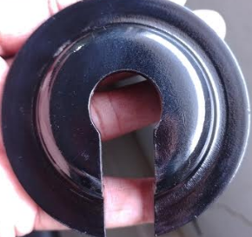
One Point Lesson
Premier Enterprises
Shop:-Final Inspection |  | Part:- TOP Spring Locator, Stage: Inspection
Types of Problem |  |  |  | Lesson no | 25
 |  |  |  | Date of preparation | 07/06/23
 | NOT OK | OK |  | Team leader | Mrs. Deshmukh
 |  |  |  | Zone leader | Mr. Kamble
Topic:- Powder coating not OK .( Part: Top Spring Locator, Part No: S2DA04511B )
KEY POINTS : Locator must be free from powder coating defect.
NOT OK
OK
Date | 07.06.22 | 08.06.22 | 09.06.23 | 10.06.23
Teacher | Mr.deshmukh | Mr.Deshmukh | Mr.Deshmukh | Mr.deshmukh
Learner | Mrs.Meera | Mr .Nilesh | Mrs.Sangita | Mr.Vikas

