Slide 1
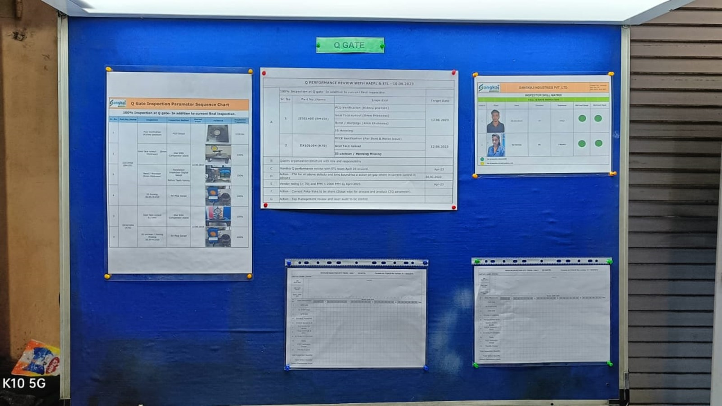
200% Q Gate Inspection Table

Slide 2
200% Q Gate Inspection Table

Slide 3
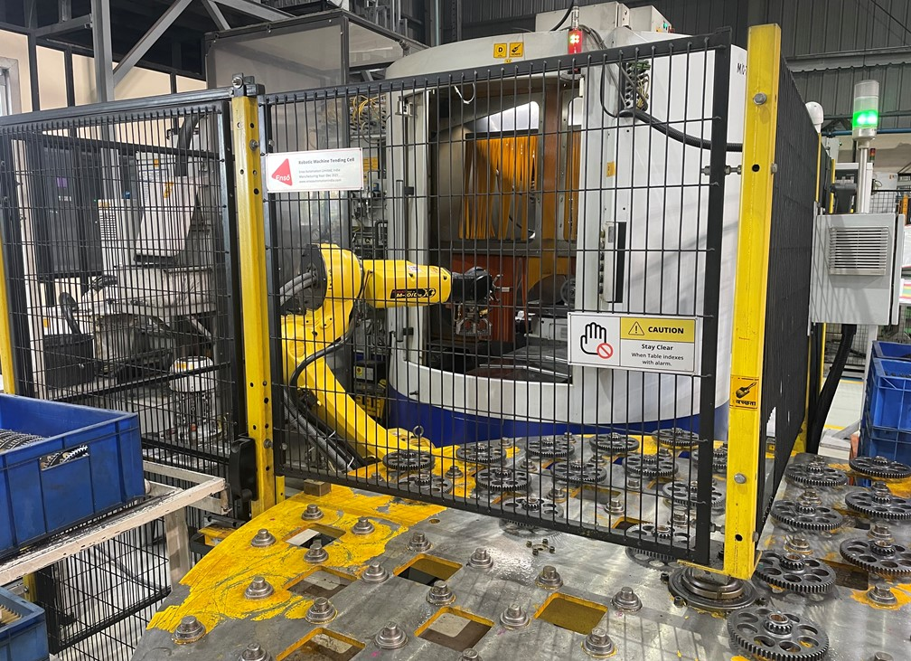
Fanuc Robot Provided For Material Loading and unloading

