Slide 1
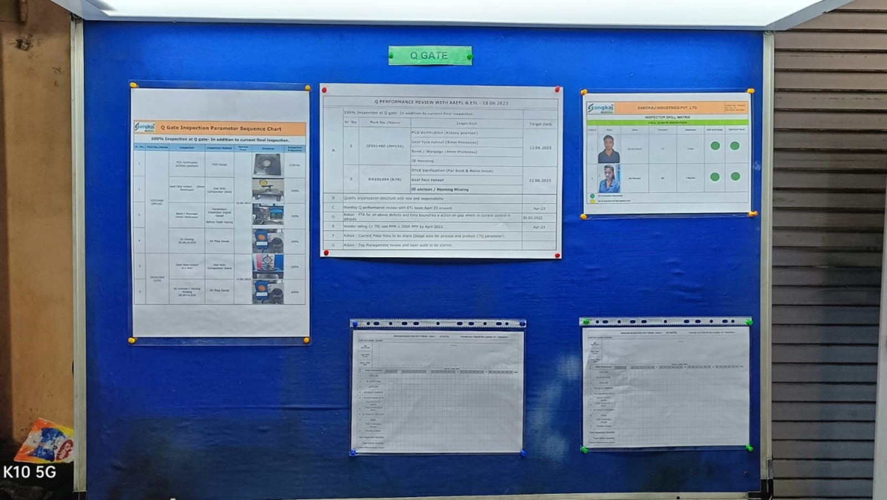
200% Q Gate Inspection Table

