Slide 1
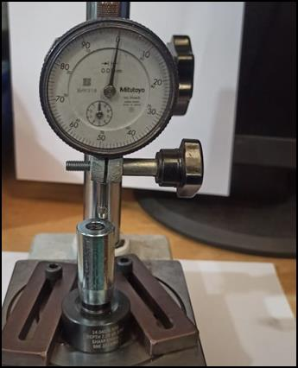
Countermeasure:- MACHINING STAGE
EVIDENSES
TRAUB OPERATION : SE/ALM/03
BEFORE
AFTER
Problem/Present Status:
Countermeasure:
M/s Sharp made available Spl. Dial type gauge for DIM 7.0+/-0.1 mm checking at final & in process inspection stage to avoid man oriented inspection. Gauge implemented & checking on daily basis.

