Slide 1
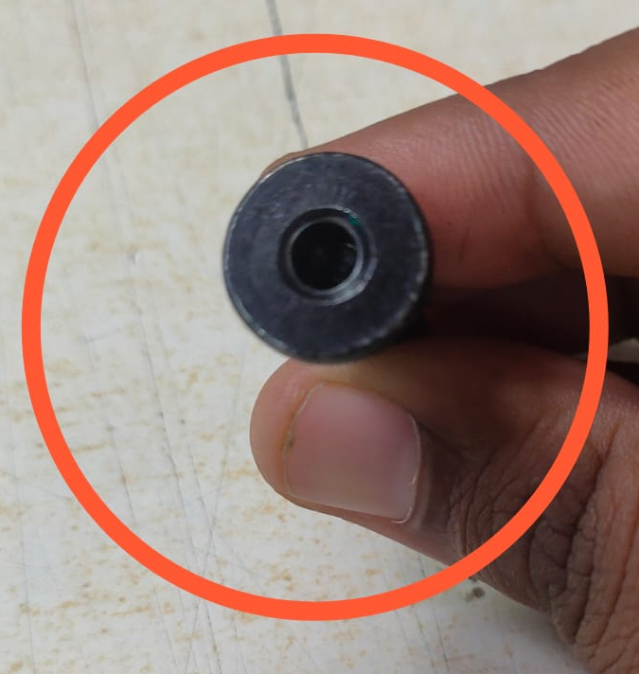
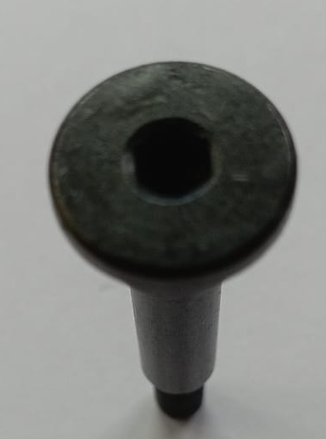
Q ALERT
Part Description- B2BQ00826O-BRAKE LEVER SCREW -C101 CBS (ROUND HEAD)
NOT OK WITHOUT HEX PUNCH
OK WITH HEX PUNCH

