Slide 1
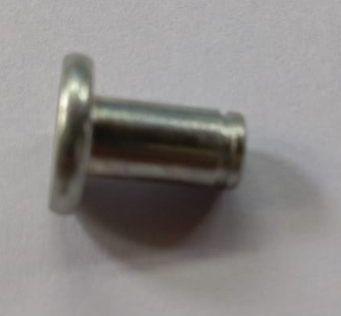
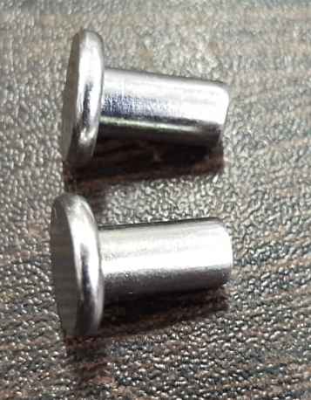
Q ALERT
Part Description - B2JU00326O-RIVET FOR CBS LINK
OK
NOT OK
With groove
Without groove and length short

Slide 2
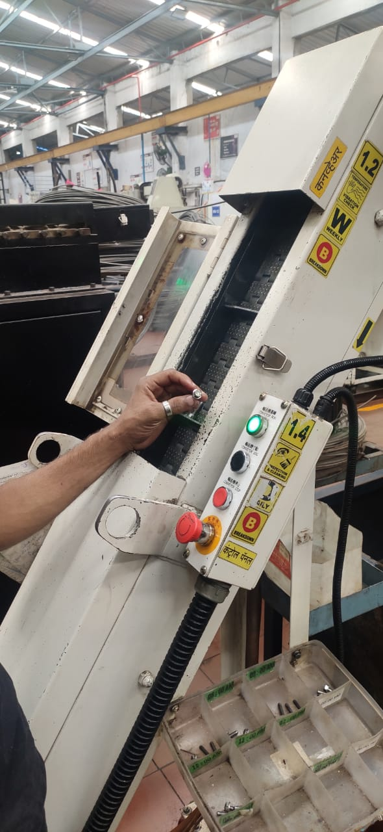
ACTION DETAILS
Clean the conveyor after setting of forging processing

