Slide 1
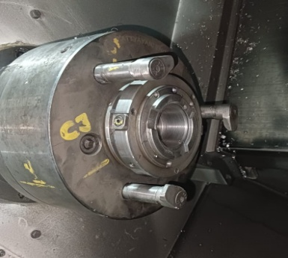
Part is now located at claw.

