Slide 1
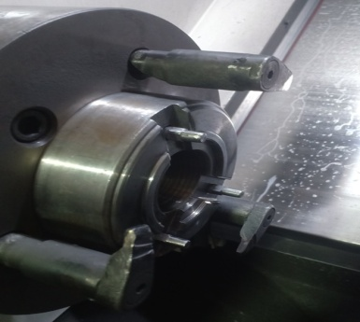
Part locating was at 3 hole ID.

