Slide 1
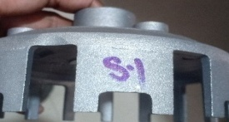
Inspection marking implemented with inspector identification to t race back.

