Slide 1
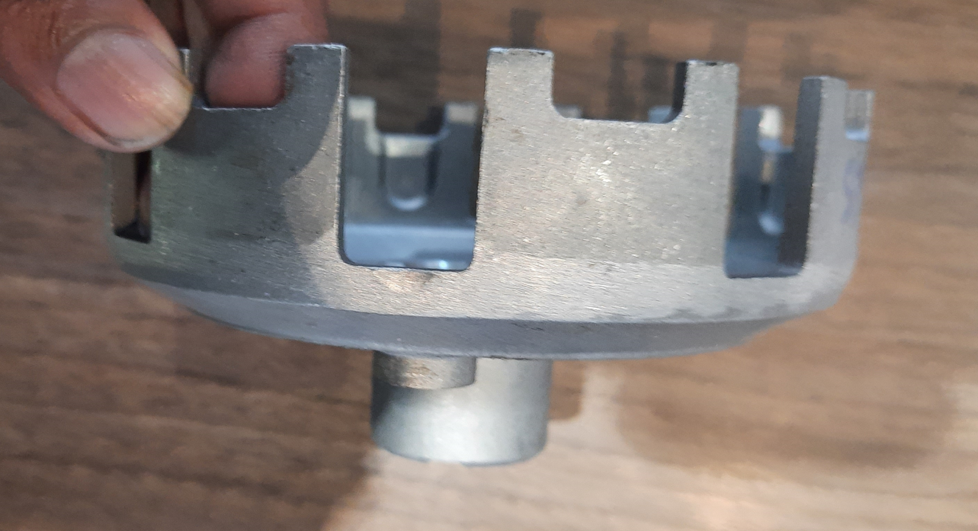
No marking for inspection.

