Slide 1
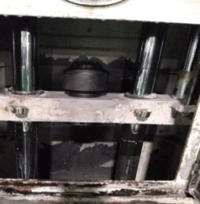
Run out fire due to play observed in broach puller

