Slide 1
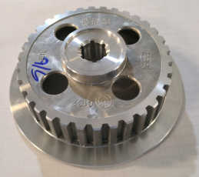
No run out reading on part for inspection

