Slide 1
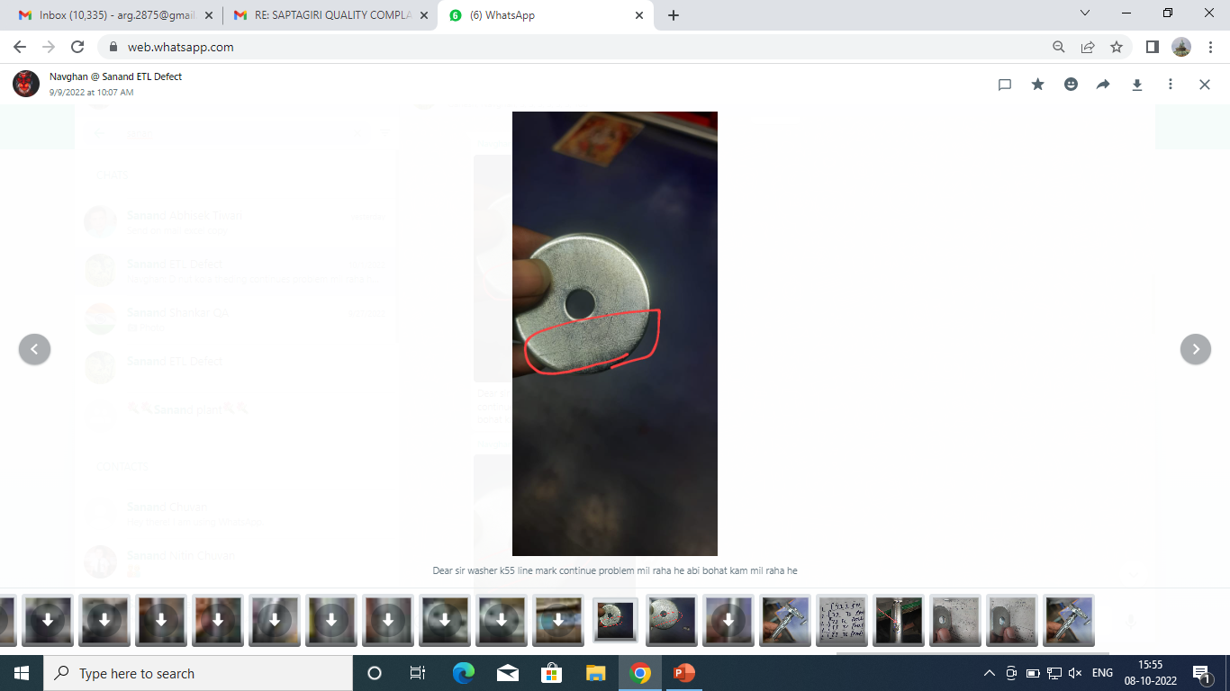
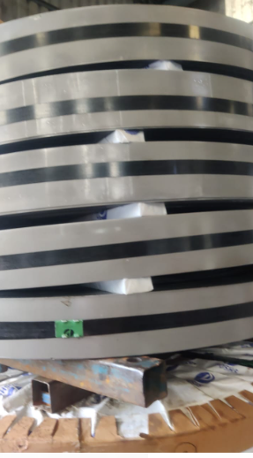
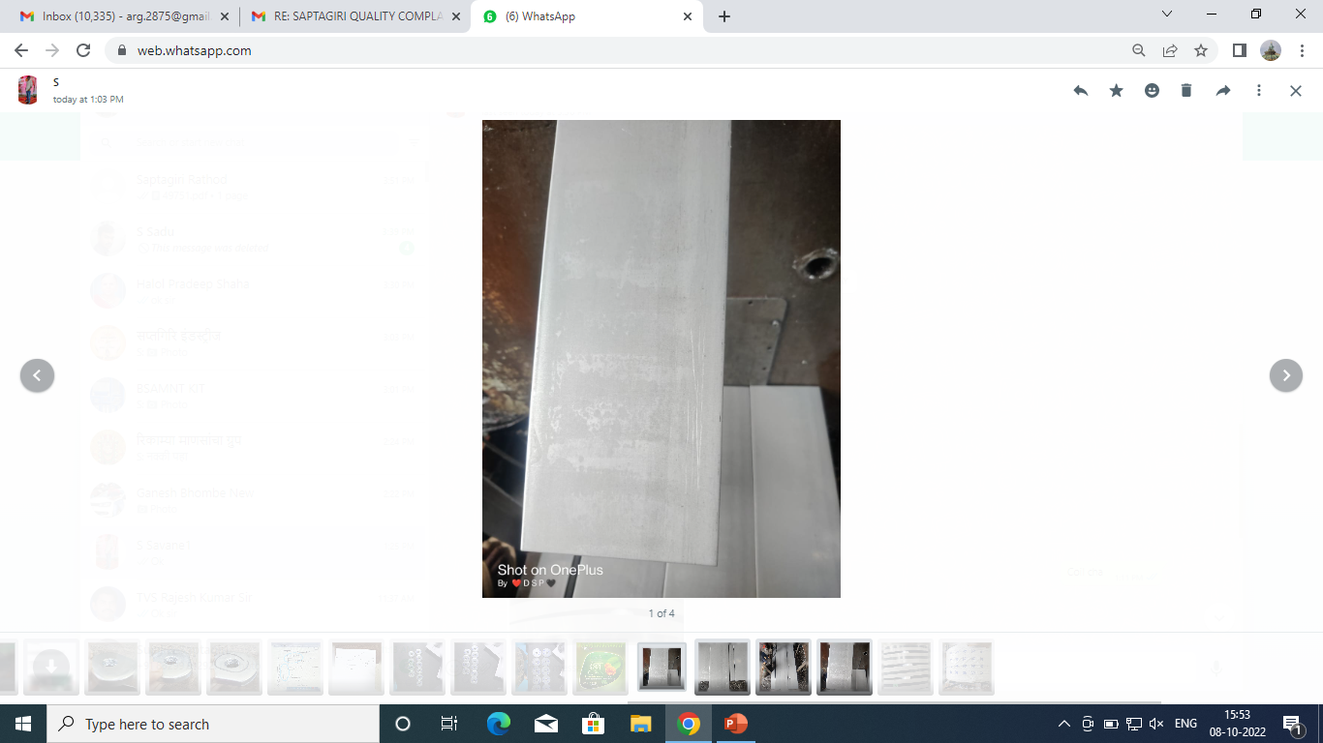
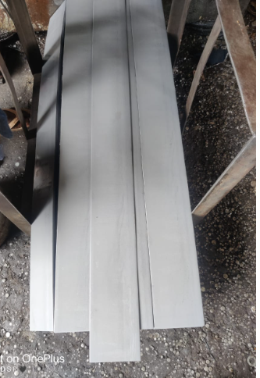
ACTIONS FOR LINE MARK ( WASHER S2PL03812B)
While blanking operation, sheets’ sharp edges draw Same scratches line mark will generate on parts | Sheet sharing operation eliminate Material will procure in coil form Sheet drawing while part producing avoided
Supplier: Saptagiri Industries.
Operation: Press shop / Machine shop
Implementation Date: 12.09.2022
BEFORE
AFTER
Problem/Present Status: Stamping mark like depth line mark at top surface of Washer K55G.
Material flow
Material flow
While blanking operation, sheets’ sharp edges draw
Sheet sharing operation eliminate
Raw material Inward
Raw material Inward
Same scratches line mark will generate on parts
Sheet Sharing
Material will procure in coil form
Coil form
Bblanking & Center hole piercing
Sheet drawing while part producing avoided
Bblanking & Center hole piercing
Plating
Plating
Final Inspection
Final Inspection
Packaging
Packaging

Slide 2
