Slide 1
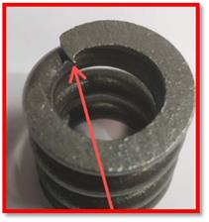
ACTION PLAN
DATE-12.08.2022
Customer Observation:- Sharp Edge at the End Coil ID.
NG
Customer Name :- ENDURANCE TECHNOLOGIES LTD.
SUPPLIER NAME :- HELICAL SPRINGS PVT. LTD.
PART NAME :- Rebound Spring (K0PG) PART No. :- (S2KH01502O)
Date :- 12/08/2022
Sharp Edge (Burr) at the end coil ID

Slide 2
Reoccurrence Prevention Why-Why Analysis [Outflow]
DATE-12.08.2022
< WHY >
< WHY >
< WHY >
<Direct Cause>
Sharp edge at the End Coil ID.
During Coiling stage mendral blunt.
Operator not check the mendral on time.
Mendral frequency to cut spring is after 50,000.
(But the mendral was blunt before as it’s frequency decided.)
Some of parts was made of Sharp edge.
Direct Cause
(1st)
Who
2nd Cause
<Why>
3rd Cause
<Why>
Constitutional cause
<Management Issue>
Outflow
Sharp edge at the End Coil ID. Not detected at final stage.
Inspector
This problem have comes very rarely. Inspector was not aware about this issue.
Inspection of similar parts inadequate.

Slide 3
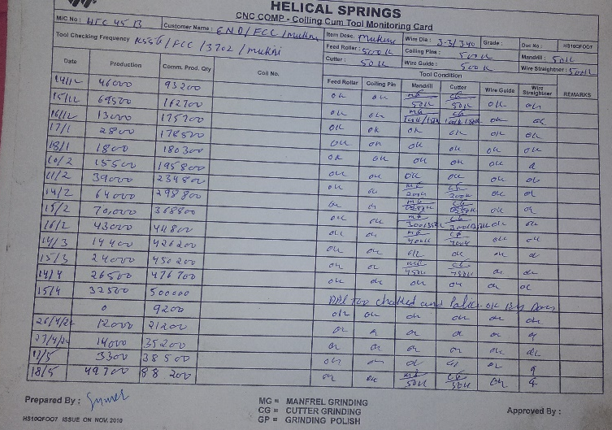
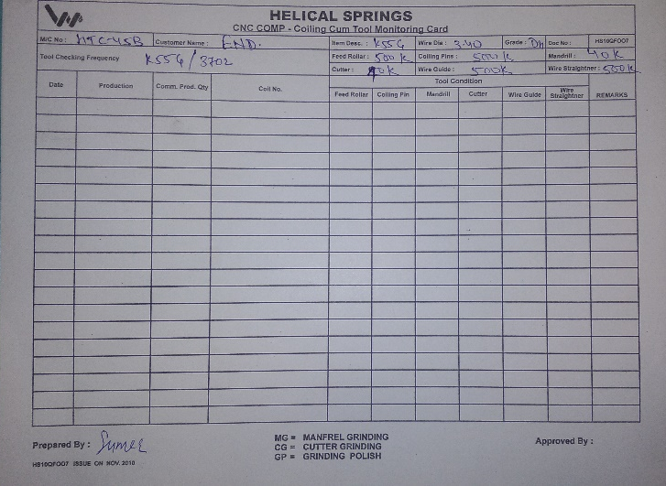
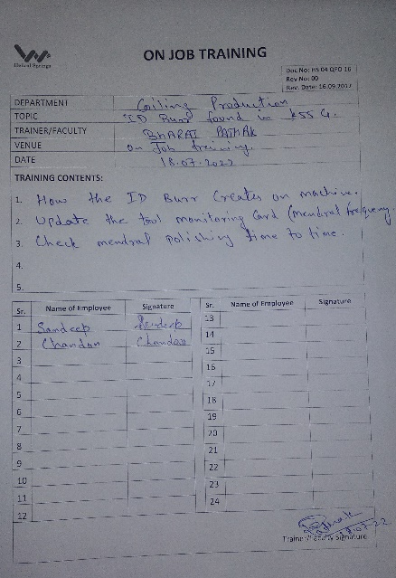
Corrective Action
DATE-12.8.2022
Part Name – Rebound Spring K0PG
Part No-S2KH015020
Mendral polishing frequency updated in tool monitoring sheet after 40,000pcs.
Training provided to operators.
2.
1.(a)
1.(b)
BEFORE
AFTER

Slide 4
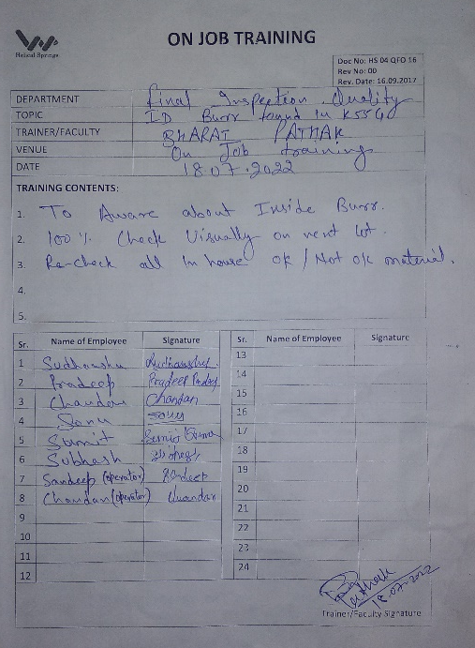
Preventive Action
DATE-16.8.2022
Part Name – Rebound Spring K0PG
Part No-S2KH015020
100% visual inspection at final stage.
Training provided to inspectors.
Quality Alert at final inspection stage.
Contentment Action:- Recheck 100% inspection of all WIP, In House & FG ‘ stock material.

Slide 5
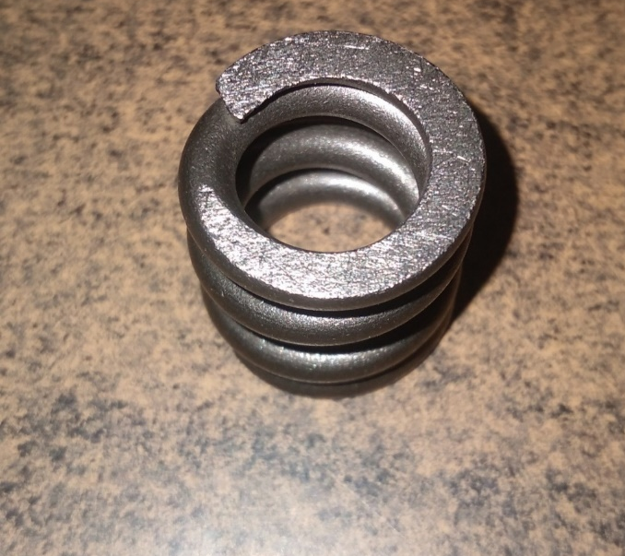
OPL
DATE-16.8.2022
Part Name – Rebound Spring K0PG
Part No-S2KH015020
NG
OK
ऊपर दिखाये गए चित्र K55G पार्ट मे ID BURR (Sharp Edge) है, जिस कारण से यह पार्ट NOT OK है।
ऊपर दिखाये गए चित्र K55G पार्ट मे ID मे कोई ID Burr नहीं है, इसलिए पार्ट ओके है।

Slide 6
Updated the Final inspection std.

Slide 7
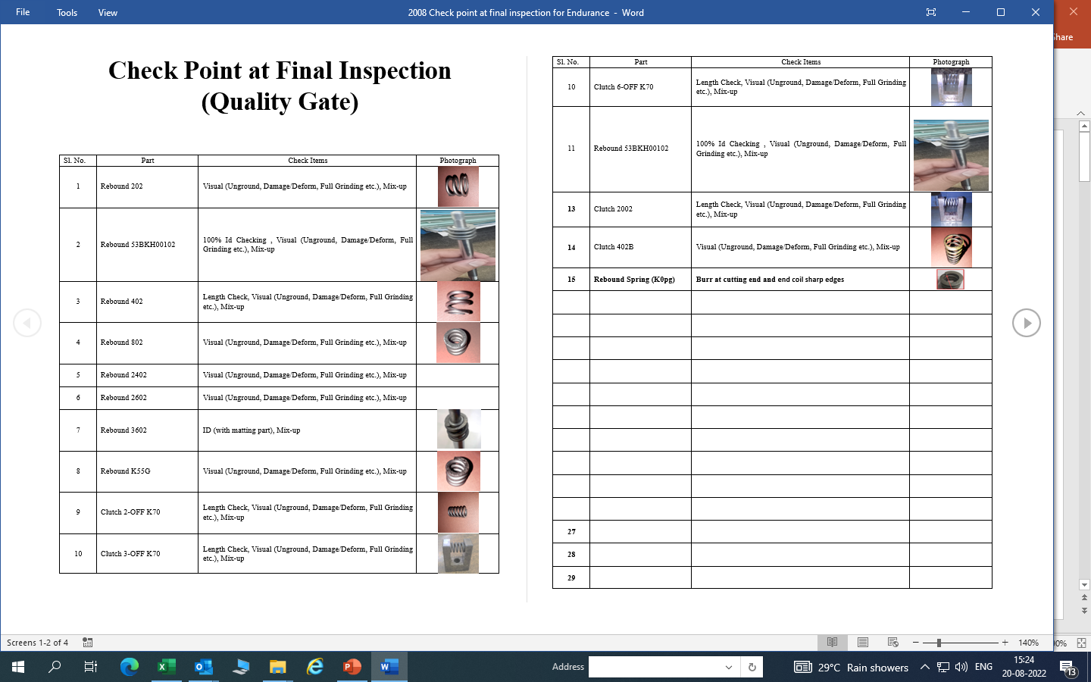
Check Point added at Final Inspection

Slide 8
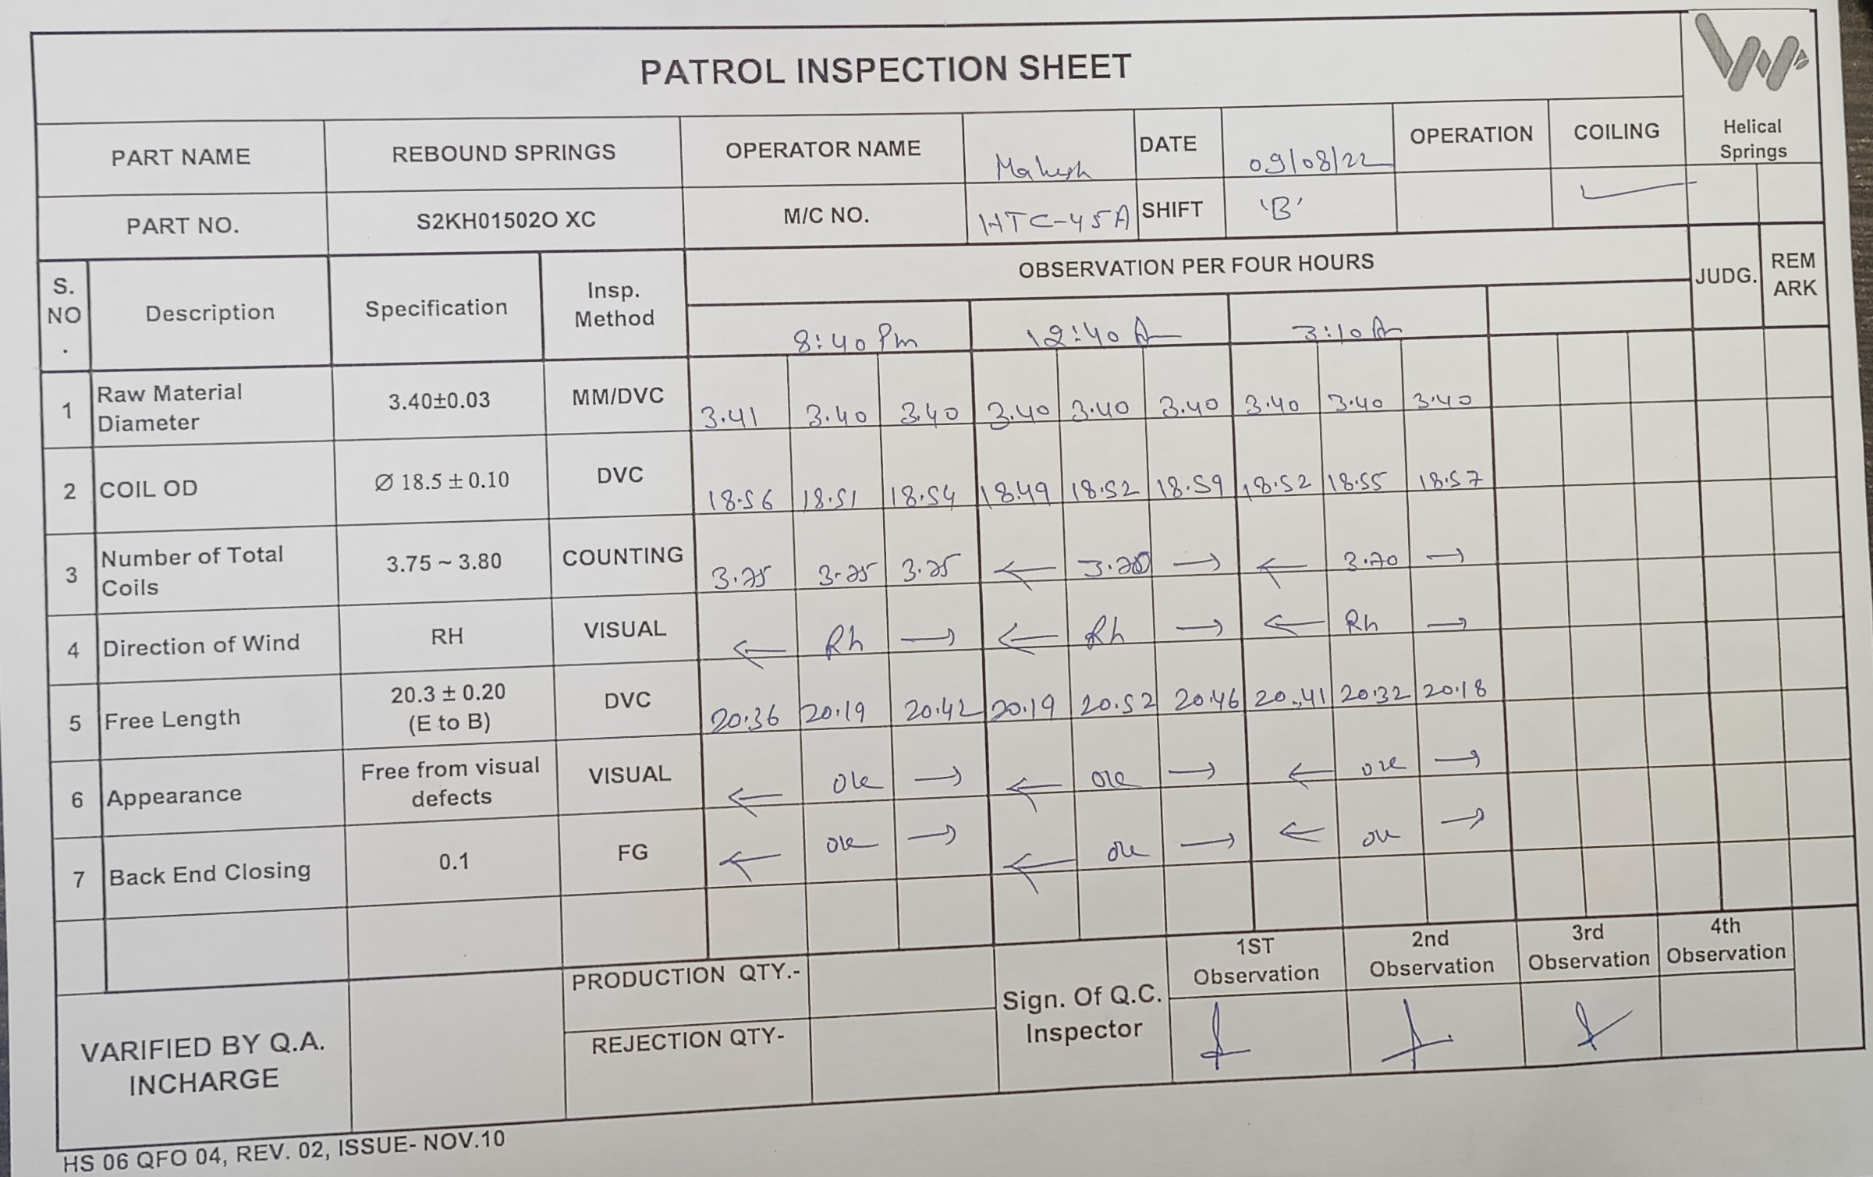
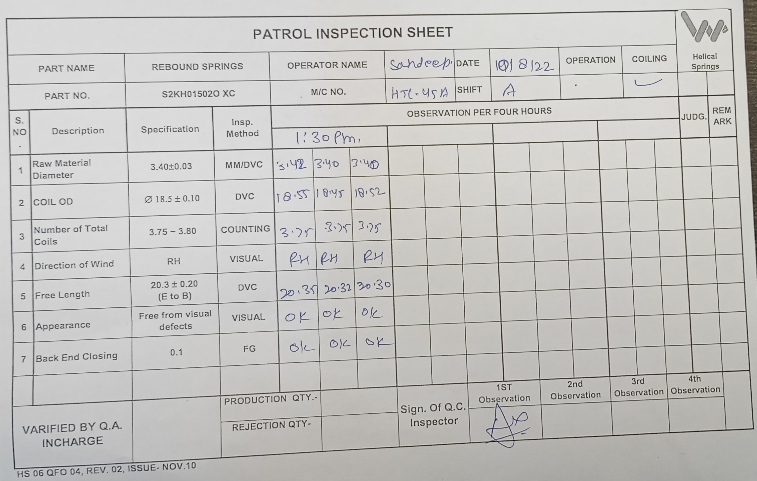
Check point added at coiling
Before
After

Slide 9
Thank You

