Slide 1
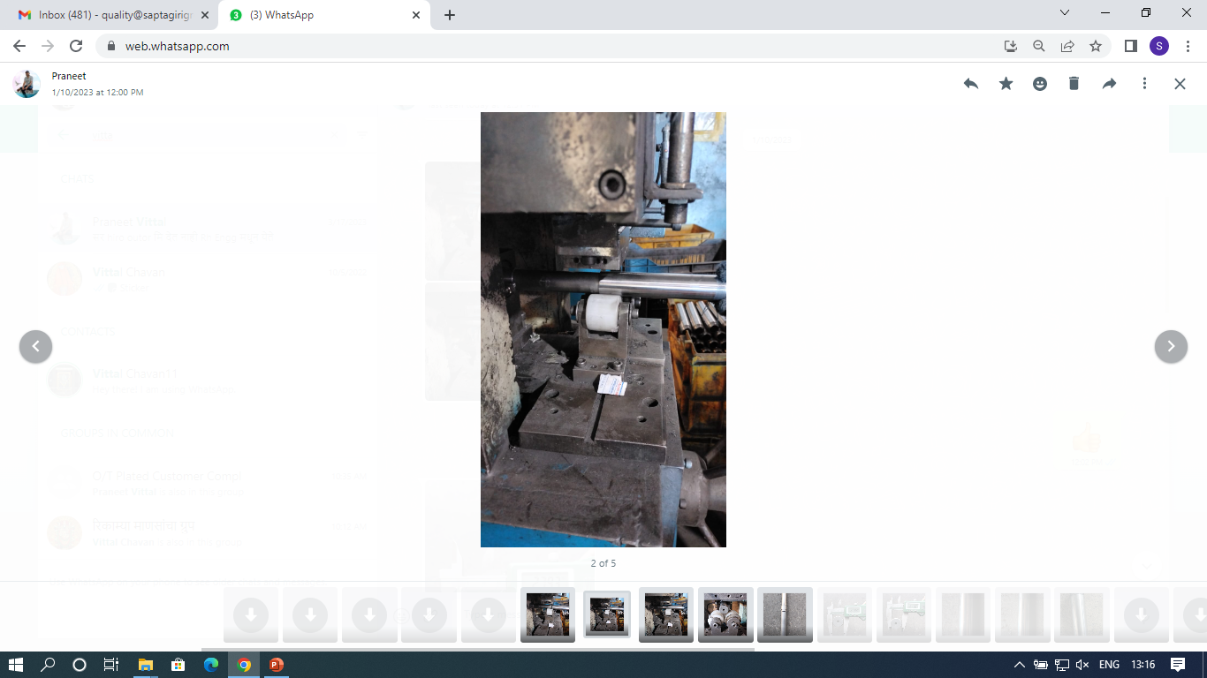
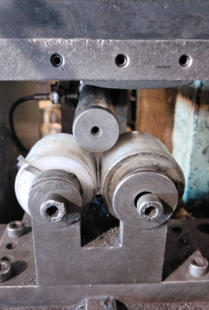
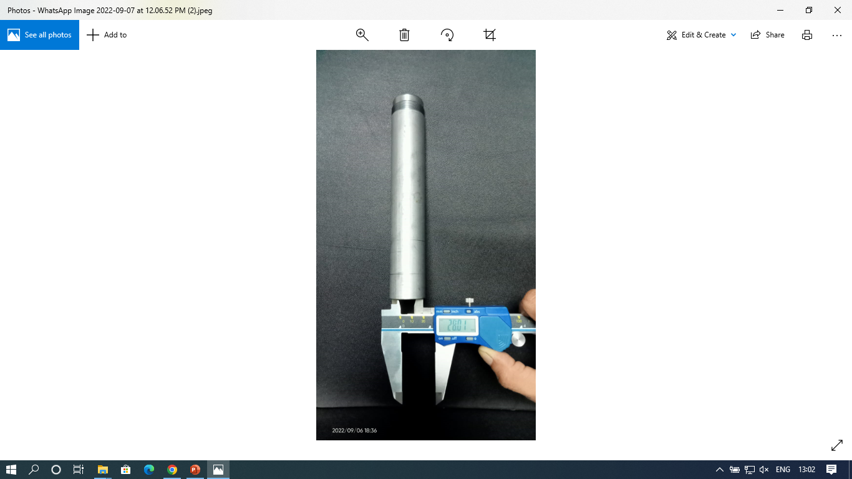
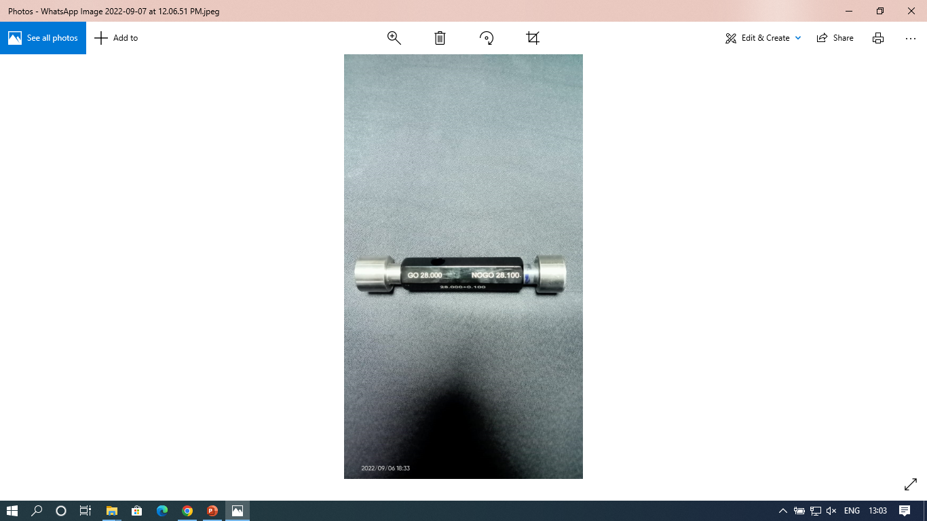
ACTIONS FOR ID OVER SIZE
Sampling inspection done only at receipt stage | At Receipt inspection sampling size increase While cutting operation every length inspect by plane plug gauge. At CNC operation sampling stared to verify tube ID 28.0 ‘’ Mandrel used at marking stage for tube guide At final inspection Q –Alert display Awareness given to final inspector to ensure tube ID
Supplier: Saptagiri Industries.
Operation: Tube Cutting shop / Machine shop
Implementation Date: 10.09.2022
BEFORE
AFTER
Problem/Present Status: ID over size observed 28.4 against 28.0 + 0.1 mm
At Receipt inspection sampling size increase
Material flow
Material flow
Sampling inspection done only at receipt stage
While cutting operation every length inspect by plane plug gauge.
RM Receipt
RM Receipt
RM Inspection
RM Inspection
Tube Cutting
At CNC operation sampling stared to verify tube ID 28.0
Tube Cutting
Both side chamfer
‘’ Mandrel used at marking stage for tube guide
Both side chamfer
Forming
Forming
At final inspection Q –Alert display
CNC Machining
CNC Machining
Buffing
Awareness given to final inspector to ensure tube ID
Buffing
Marking
Marking
Ni. Cr. Plating
Ni. Cr. Plating
Final Inspection
Final Inspection
Packing
Packing

