Slide 1
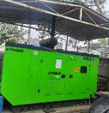
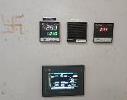

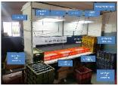
Action and Implementation
Part Name | Part No | Supplier | Defect | Actions | Photos | T. Date | Status
PRELOAD ADJUSTER - K17C RSA Ø30 BORE | S2AB02907B | SAPATGIRI ENGINEERING PVT.LTD. | Defect Phenomenon – POWDER COATING UNCOVER Date : 06-09-2022 Rejection Qty : 60 Root Cause: / Possible causes: 1 POWDER COATING NOT OK-POWDER COATING UNCOVER 2 Variation in baking temperature 3 Baking temperature not validated by TTR | Containment action: 100 % material verified at ETL and Saptagiri End Cause Side Action: 1 For any power failure DG set available 2 Sensor and limit switches installed as a poka yoke (Inter locking System ) for conveyor ( If oven temperature increases or decreases by any reason so conveyor will not run ) 3 Separate booth provided to avoided NG part mix Inspection side action: 1- 100% Inspection started along with identification mark. 2- Q- Alert Display at work place and final inspection stage. 3- Lux level monitored daily at final inspection stage Sustenance : 1 Awareness verify once in month by poison test |  | 14-10-2022 | Completed

