Slide 1
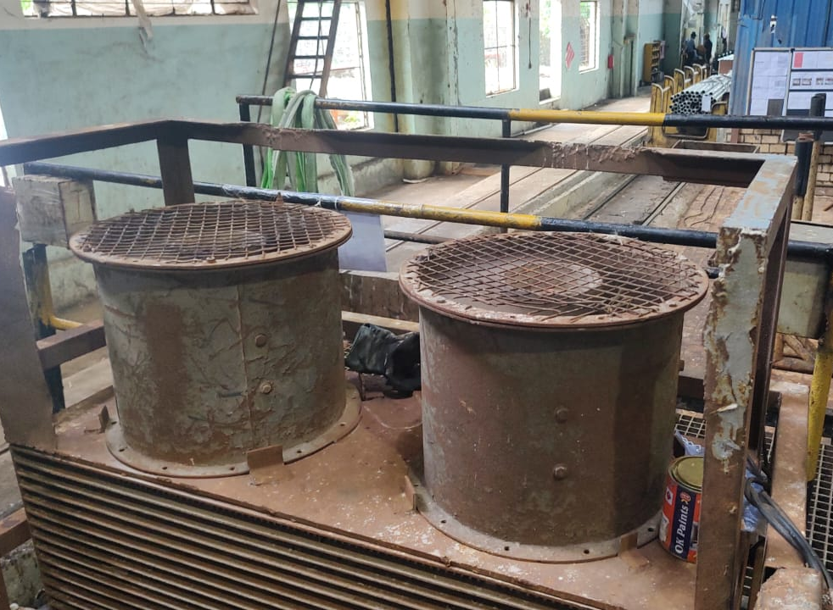
Before & After Comparison of Actions
Left side sucker was not working.
Before
After
Description :- Left side sucker got failed.
Description :- Both sucker made working.

Slide 2
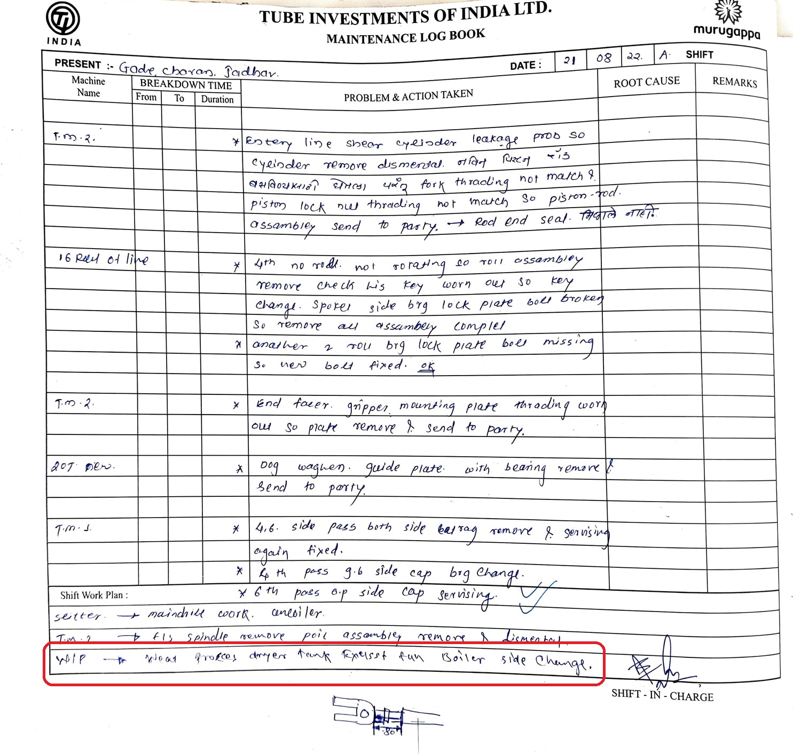
MAINTENANCE LOG BOOK

