Slide 1
Inspection Side Before & After
Inspection was done on sampling basis.
(IS 4711 - 1974)
100 % Inspection will be done at both ends of the tube. (Next three Lots)
Before
After
Inspection System :- As per sampling plan.
Inspection Method :- Visual. (By finger)
Inspection Location :- Final Inspection.
Inspection Frequency at Each Location :- Sampling basis. (IS 4711 - 1974)
Other Details :- On draw bench during first off , 2nos & hourly Visual. (By finger)
Inspection System :- 100% .
Inspection Method :- Visual (By finger) at both tube end. Ref. Photo provided.
Inspection Location :- Final Inspection.
Inspection Frequency at Each Location :- Sampling qty doubled during final inspection. (IS 4711 - 1974)
Other Details :- On draw bench during first off , 2nos & hourly Visual. (By finger)

Slide 2
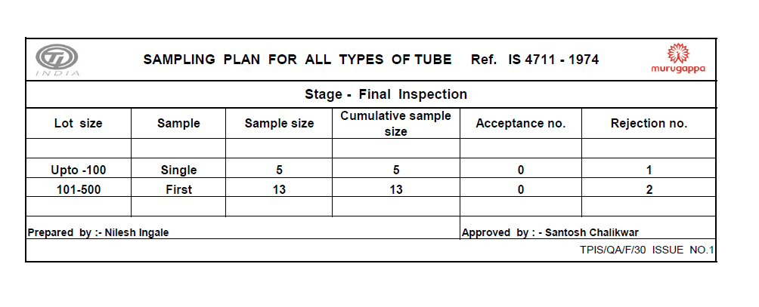
Sampling Plan

Slide 3
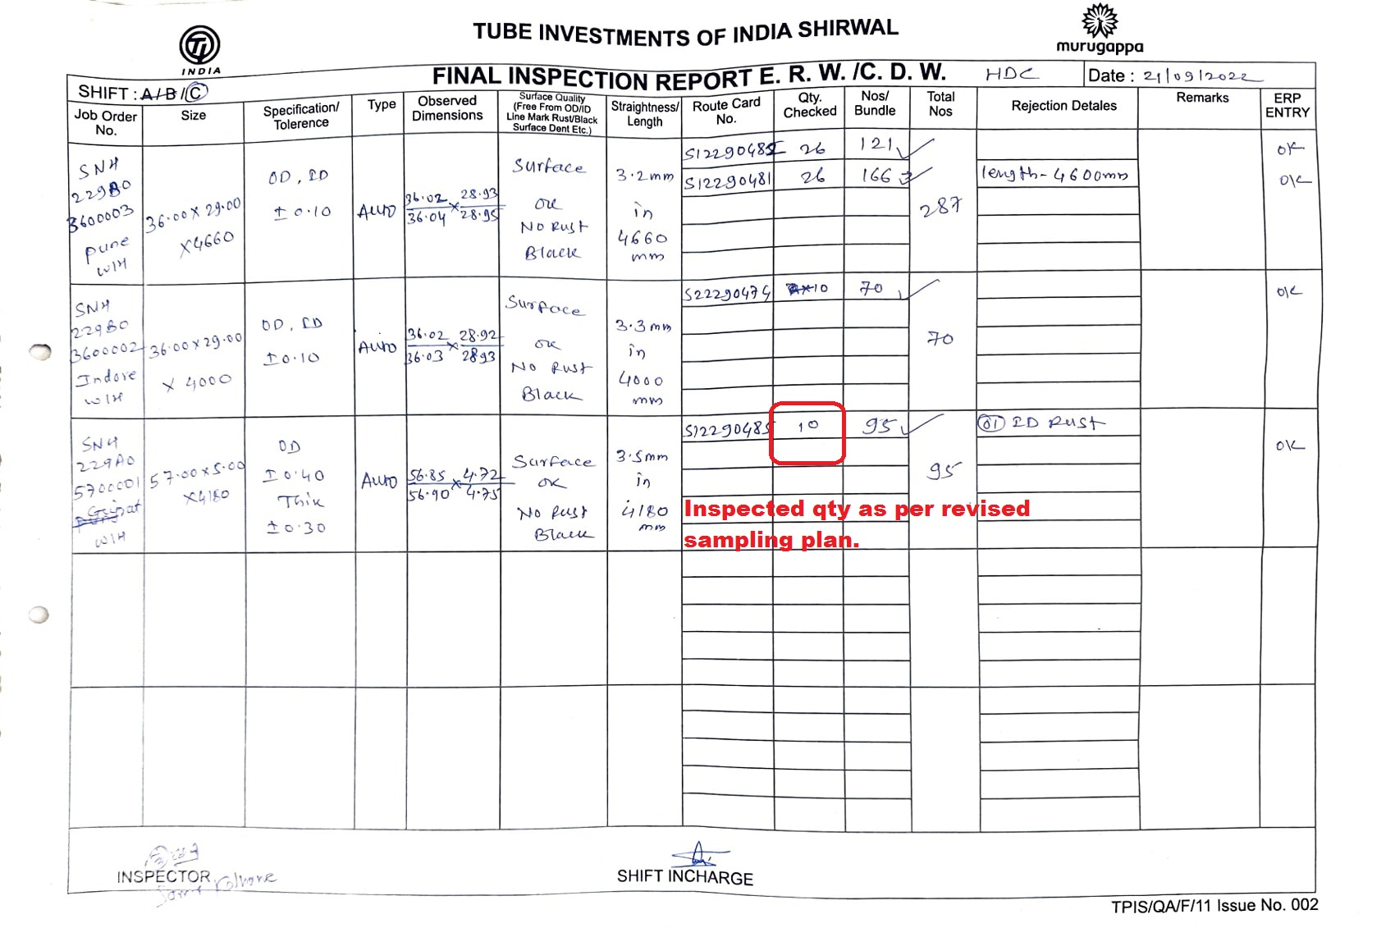
Final Inspection Report

Slide 4
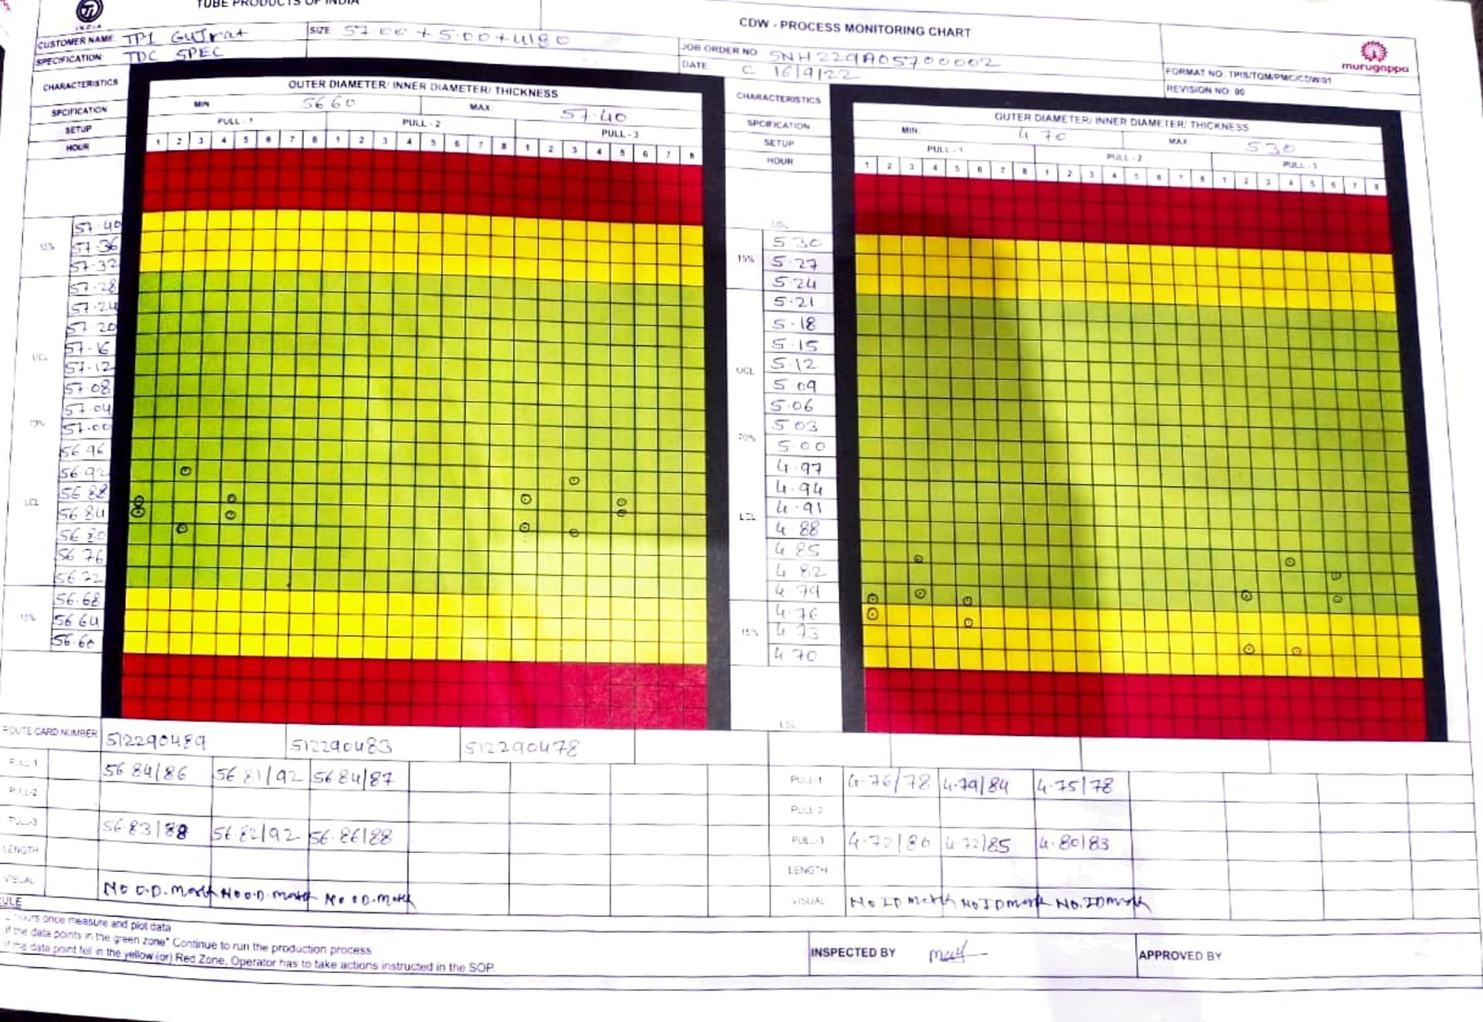
Process Monitoring Chart (PMC )

