Slide 1
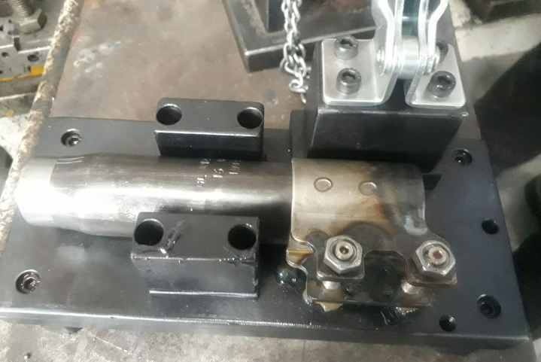
After
Used standard nut

