Slide 1
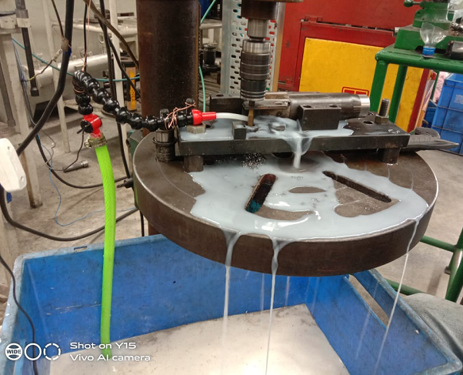
Accrete Electromech Pvt Ltd
Before
Auto Coolant control (Coolant motor interlock with cycle)

