Slide 1
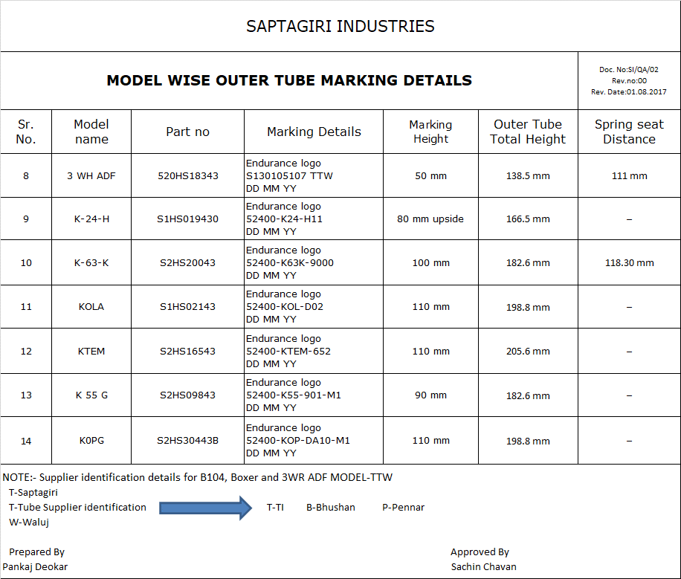
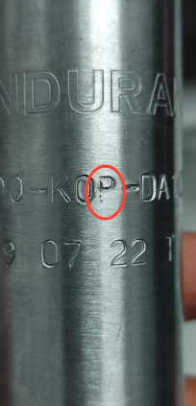
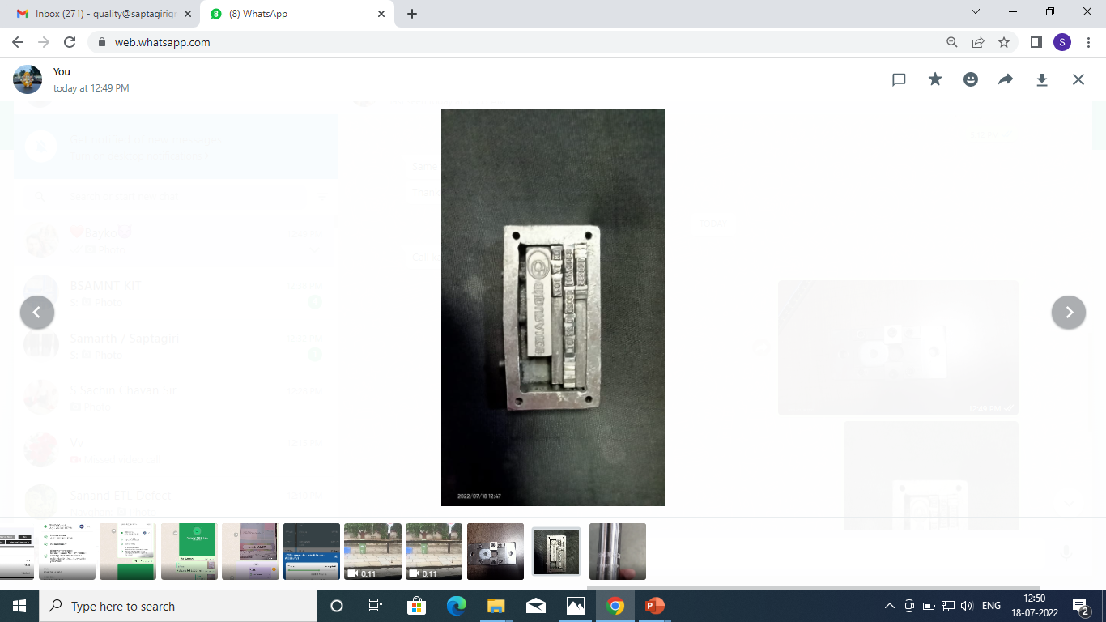
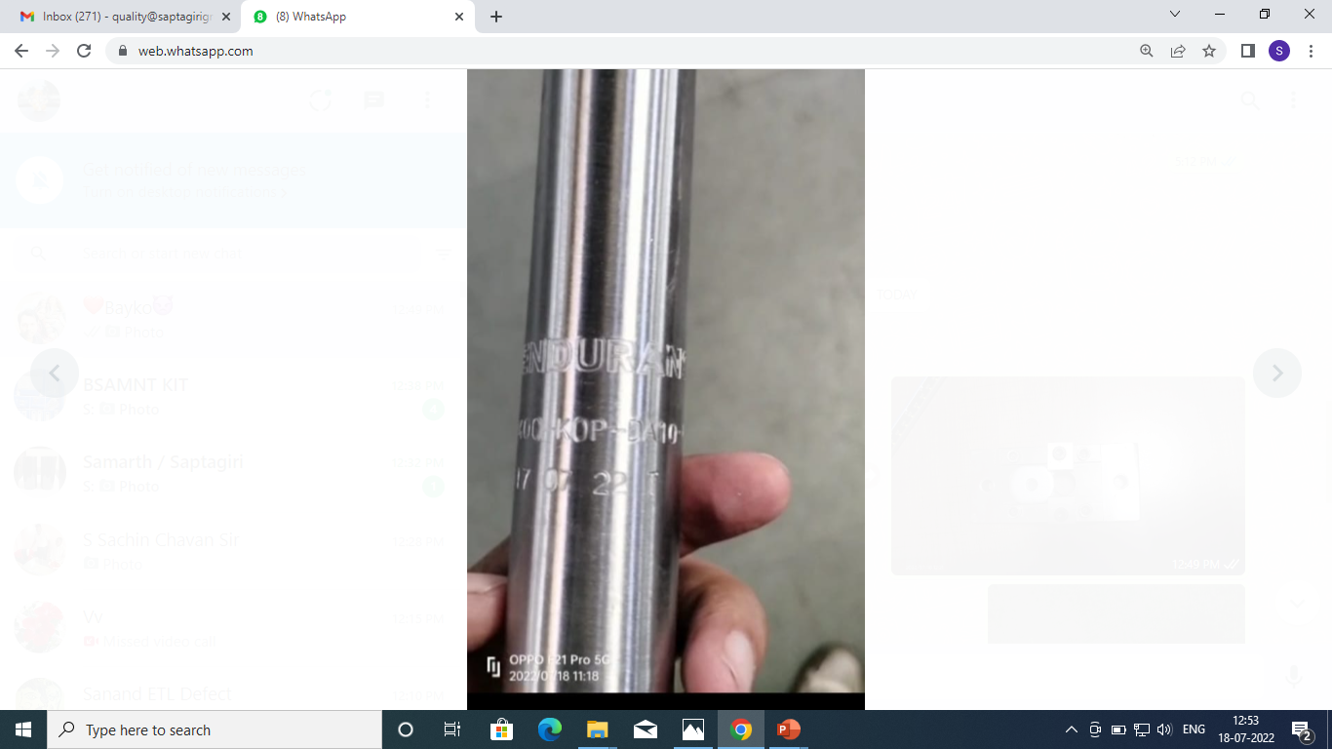
ACTIONS FOR NG MARKING ( K0PG )
Inadequate material handling for Input & Output material after stamping operation Not aware inspector and operator about stamping and it`s details | Input & Output material provided bin is different colour for Input Blue colour and for output Green colour Made SOP for material handling at stamping stage Q- Alert Display at final inspection Input & Output material Identified
Supplier: Saptagiri Industries.
Operation: Press shop / Machine shop
Implementation Date: 22.09.2022
BEFORE
AFTER
Problem/Present Status: Marking letter 'P' observed v1ithincomplete marking & due to this letter 'P' observed as letter 'F'.
Broken punch replace with new one
Material flow
Material flow
One point lesion made and display at work place
RM RECEIPT
Marking letter 'P' observed v1ithincomplete marking & due to this letter 'P' observed as letter 'F'.
RM RECEIPT
RM Inspection
Aawareness training given to concern inspector and operator
RM Inspection
“P” Letter punch broken in running operation
Cutting
Blanking
Final Inspector not aware
Both side chamfer
Both side chamfer
Buffing
Buffing
Marking
Marking
Final Inspection
Final Inspection
Packing
Packing

