Slide 1
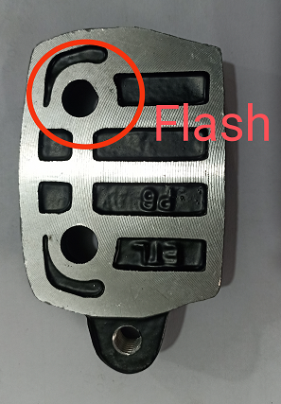
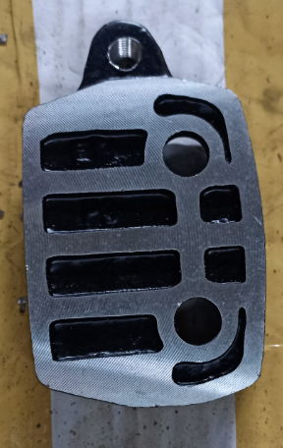
Action plan
Before
After
Part Name | Model | Supplier | Defect | Actions | T. Date | Status
Caliper Body LH |  | Praneel Industries | Defect Phenomenon –Burr/ flash Fold Inside the Dia 10 mm Why 1:Core Pin Diameter undersize Why 2: Core Pin wear out Why 3: Core pin life not monitored. Root Cause: Flash fold inside hole 10 mm due to core wear out | Containment action: 100% stock inspected at ETL and supplier end and ok parts to line with identification mark Inspection side action: 1. 100% Inspection done at final inspection with Green dot identification mark. 2.Q-Alert display at Final Inspection & Machine Cause Side Action: Core Pin replaced After 25000 shots core pin to be replace C.D. Checking point added to daily check sheet | 01.10.2022 | Completed

Slide 2
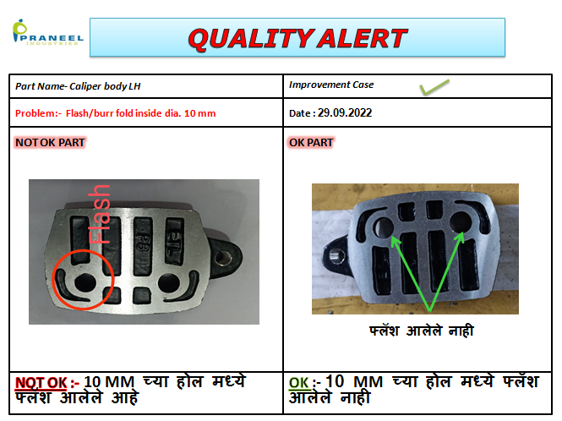
Quality Alert

Slide 3
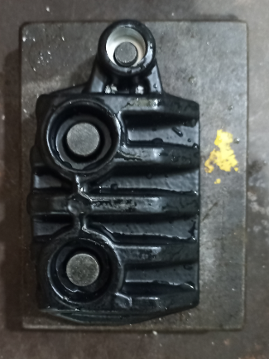
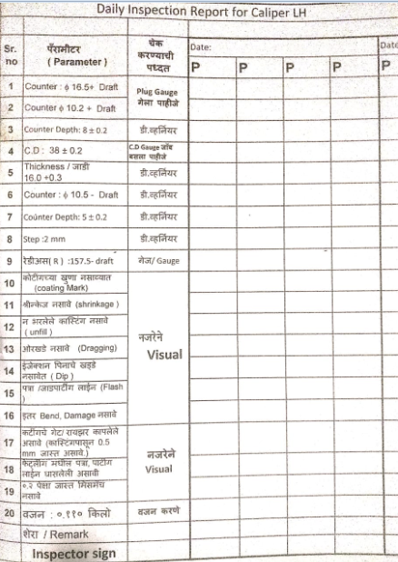
Improvement in Inspection
Inspection Frequency Change
C.D Checking in Daily Check Sheet
100 % checking added before dispatch
Daily Inspection Check sheet

Slide 4
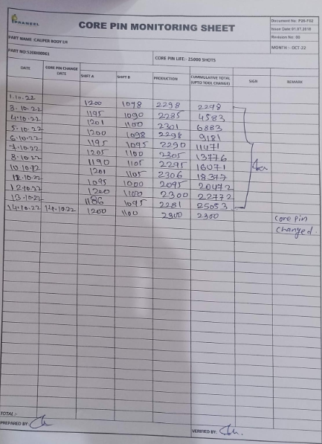
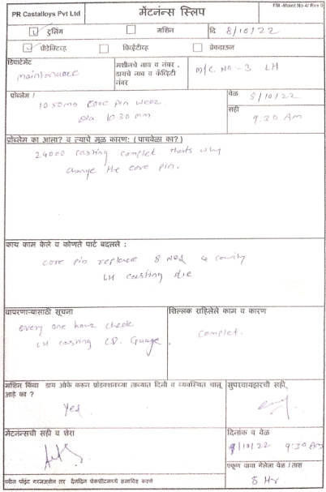
Core Pin Monitoring Sheet

Slide 5
THANK YOU

