Slide 1
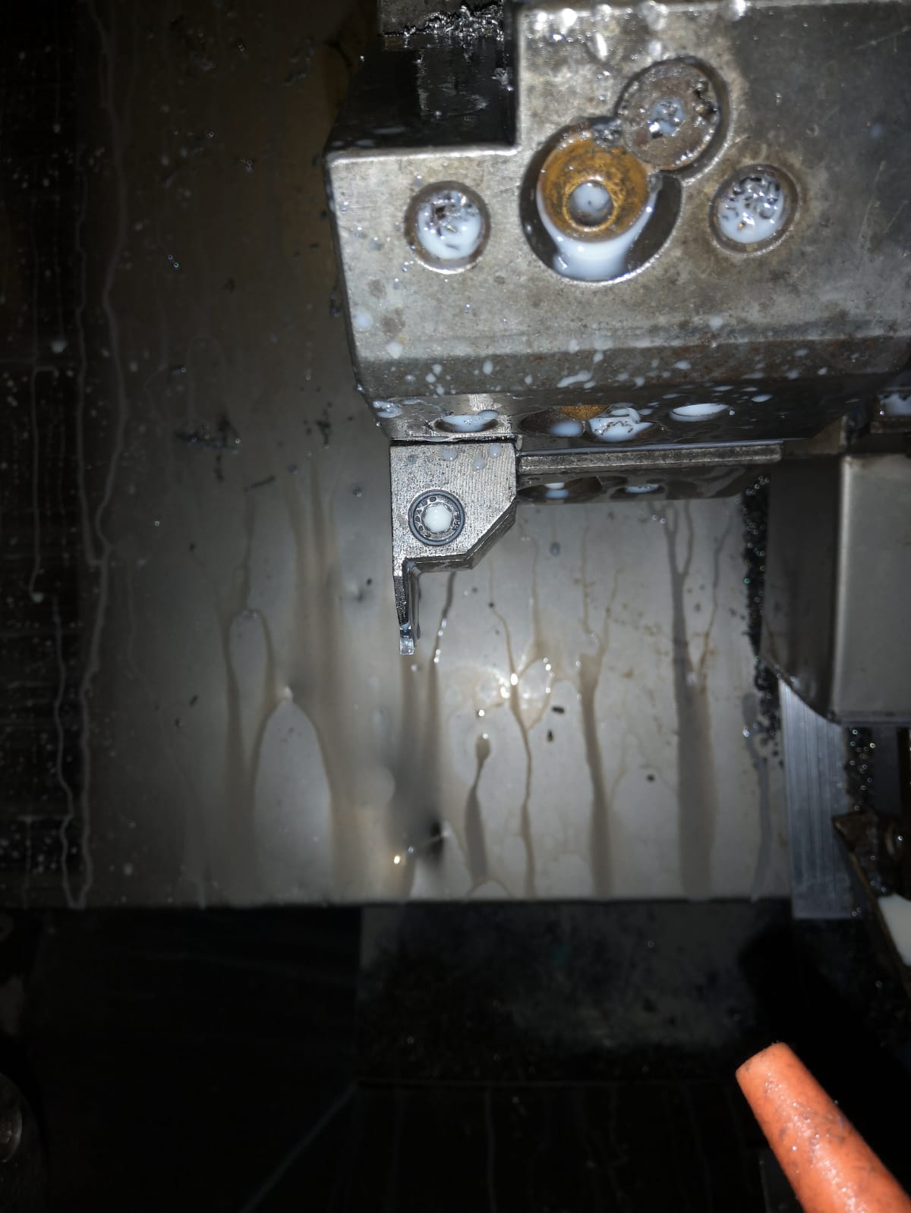
ACTION PLAN FOR FORK BOLT PRFH 3.0+0.2 GROOVE WIDTH DIMENSION OVERSIZE
Component : FORK BOLT PRFH
Date of Implementation : 10.10.2022
Stage : CNC Machining
AFTER
Countermeasure:- Tool holder changed

