Slide 1
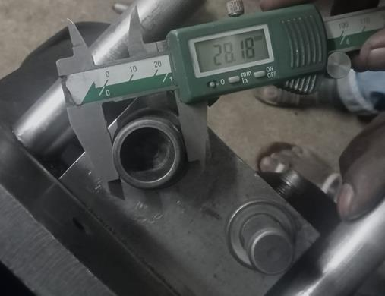
Countermeasure:- Machining stage
DRILL MACHINE :- SE/PRESS/01 Date: 31/10/2022
BEFORE
AFTER
Problem/Present Status:
Countermeasure: Fixture holding diameter Ø28.10+0.1 is corrected as per requirement, Parts which are having under size for inner diameter will not passes easily and detectable.
Benefits :- Customer complaint eliminated permanently.

