Slide 1
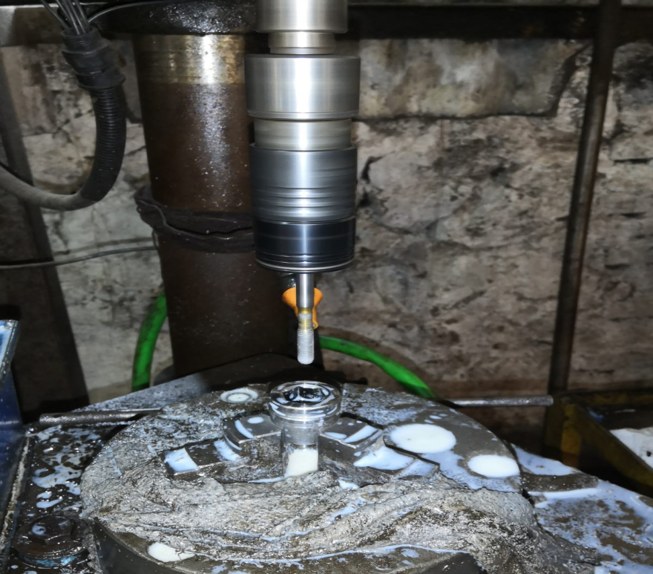
ACTION PLAN FOR FORK BOLT M6 TAPPING NO-GO PASS
Component : Fork Bolt K-17E
Date of Implementation : 12.12.2022
Stage : Traub Machining
AFTER
Countermeasure:- Collet replaced with new one having close clamping having facility of clamp more area of drill bit. so that overhanging possibility get eliminate.

