Slide 1
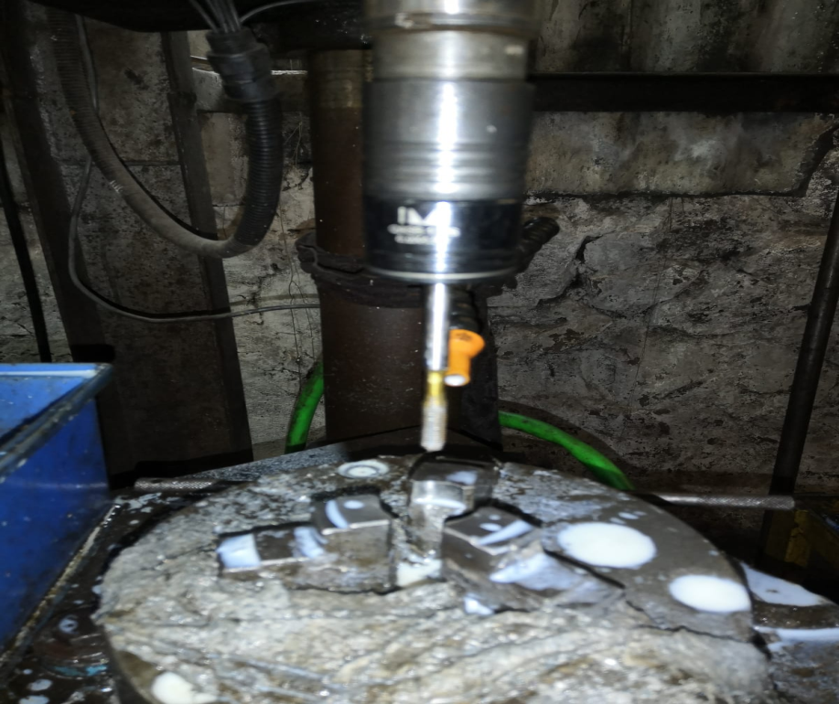
ACTION PLAN FOR FORK BOLT M6 TAPPING NO-GO PASS
Component : Fork Bolt K-17E
Date of Implementation : 12.12.2022
Stage : Traub Machining
BEFORE
Present Status :-Collet Wear Out drill bit overhanging due to clamping area less.

